Slide 1

IoF Systems Engineering Working Group
ict4sm.epfl.ch/
Jinzhi Lu
ICT for Sustainable Manufacturing
jinzhi.lu@epfl.ch
Jinzhi Lu， James Logan and Dimitris Kiritsis
@ 2020.12.8 MEETING
EPFL–11.2020
EPFL, École Polytechnique Fédérale de Lausanne
Chair of IOF Systems Engineering WG

Slide 2
Interface
1. A shared boundary between two functional units, defined by various characteristics pertaining to the functions, physical signal exchanges, and other characteristics. (ISO/IEC 1993)
2. A hardware or software component that connects two or more other components for the purpose of passing information from one to the other. (ISO/IEC 1993)
3. To connect two or more components for the purpose of passing information from one to the other. (ISO/IEC/IEEE 2009)
Sources
From SEVOCAB (www.computer.org/sevocab):
(1) and (2) ISO/IEC. 1993. Information technology--Vocabulary--Part 1: Fundamental terms. Geneva, Switzerland: International Organization for Standardization (ISO)/International Electrotechnical Commission (IEC), ISO/IEC 2382-1:1993.
(3) ISO/IEC/IEEE. 2009. Systems and Software Engineering - System and Software Engineering Vocabulary (SEVocab). Geneva, Switzerland: International Organization for Standardization (ISO)/International Electrotechnical Commission (IEC)/ Institute of Electrical and Electronics Engineers (IEEE). ISO/IEC/IEEE 24765:2009.

Slide 3
A distinction made by an observer which marks the difference between an entity he takes to be a system and its environment. (Checkland 1999, 312)
Source
Checkland, P. 1999. Systems Thinking, Systems Practice. New York, NY, USA: John Wiley & Sons.

Slide 4
A viewpoint is a specification of the conventions and rules for constructing and using a view for the purpose of addressing a set of stakeholder concerns (OMG 2010)
Source(s)
OMG. 2010. OMG Systems Modeling Language (OMG SysML™), Version 1.3. Needham, MA, USA: Object Management Group. Available at http://www.omg.org/technology/documents/domain_spec_catalog.htm#OMGSysML - derived from IEEE 1471.
A representation of a system from the perspective of a viewpoint. (OMG 2010)
Sources
OMG. 2010. OMG Systems Modeling Language (OMG SysML™), Version 1.3. Needham, MA, USA: Object Management Group. Accessed on 11 September 2012. Available at http://www.omg.org/technology/documents/domain_spec_catalog.htm#OMGSysML - derived from IEEE 1471.
concern
1. [system] interest in a system relevant to one or more of its stakeholders [ISO/IEC TS 24748-1:2016 Systems and
software engineering — Life cycle management — Part 1: Guide for life cycle management, 2.13; ISO/IEC/IEEE
15288:2015 Systems and software engineering — System life cycle processes, 4.1.12; ISO/IEC/IEEE 42010:2011
Systems and software engineering — Architecture description, 3.7] 2. interest in something relevant to one or more
of its stakeholders [ISO/IEC TR 12182:2015 Systems and software engineering — Framework for categorization of IT
systems and software, and guide for applying it, 3.2]
A defined function to be performed by a project team member, such as testing, filing,inspecting, coding. A Guide to the Project Management Body of Knowledge (PMBOK® Guide) — Fifth Edition.

Slide 5
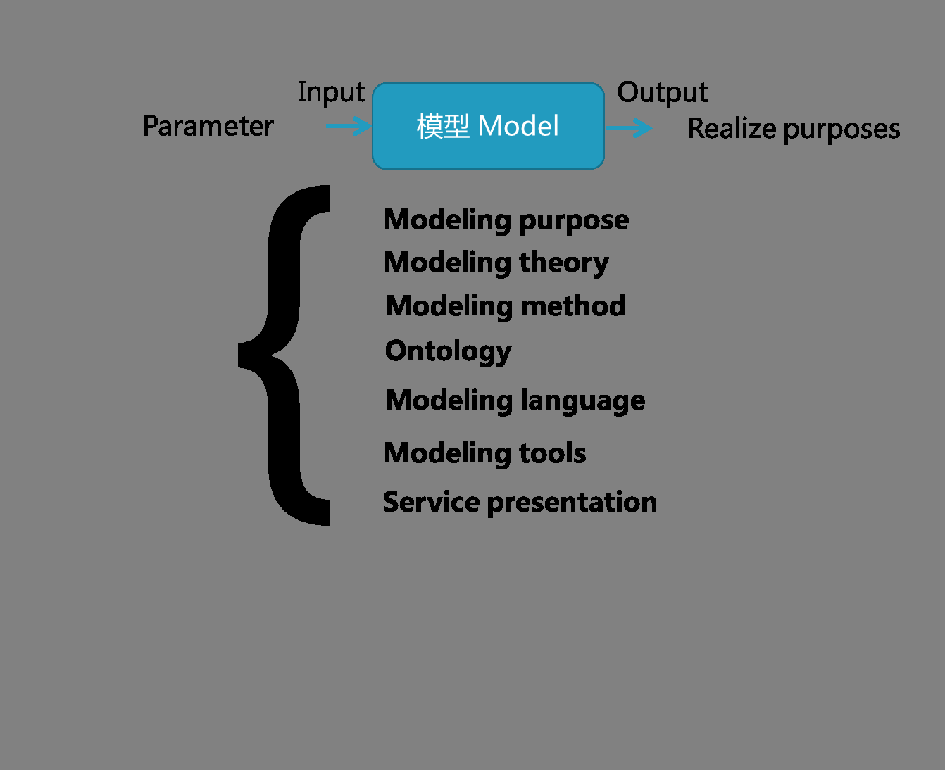
Models
Model refers to a representation of a person or a system which provides some information about it.
Model purpose: the purposes of modeling, “why is the model needed?”
Modeling theory: the mathematical foundation of modeling, e.g. differential-algebraic system of equations.
Modeling language: any language expressing information or knowledge or systems in a structure that is defined by a consistent set of rules.
Modeling tool: tools implementing models.
Modeling method: a set of concepts to explain “how to develop models using a given language in one modeling tool to represent the formalisms?”, e.g. finite element modeling and structural equation modeling.
Ontology representation: unified formalisms representing models of different languages in the CPS development.
10

Slide 6
Models
Service representation: service descriptions of models. The service refers to technical resources and activities that cause a state transformation of a technical resource for models, such as changing a parameter in a Simulink model.
11

Slide 7
System characteristic
System characteristic
System characteristics are qualities that can be used to describe and document a system.
https://simplicable.com/new/system-characteristics

Slide 8
System characteristic
Cyber physical System
A cyberphysical system (CPS) is a computer system in which a mechanism is controlled or monitored by computer-based algorithms.
"US National Science Foundation, Cyber-Physical Systems (CPS)"

Slide 9
System characteristic
The Internet of things (IoT) describes the network of physical objects—“things”—that are embedded with sensors, software, and other technologies for the purpose of connecting and exchanging data with other devices and systems over the Internet.
https://en.wikipedia.org/wiki/Internet_of_things

Slide 10
hierarchy…
Hierarchy
(1) A hierarchy is an arrangement of items (objects, names, values, categories, etc.) in which the items are represented as being "above," "below," or "at the same level as" one another. Levels in a hierarchy may also represent authority, control or ownership of lower levels (command structure). (Oxford English Dictionary 2012)
(2) Organisation of system elements into groups of (sub-)system wholes, based on relative strenght of element cohesion. (Simon 1962)
(3) The hierarchy principle of systems, is the consequential concept of simultaneous multiple containment of one system by many containing systems. (Checkland 1999)
(4) An abstract view of a defined system that is developed to meet some need. The system results from an analysis that decomposes a system into constituent elements at two or more levels. Often based around a defined taxonomy of levels covering System, element, Subsystem, assembly, components and parts. (INCOSE 2011)
Source
(1) Oxford English Dictionary, s.v. "Hierarchy."
(2) Simon, H.A. 1962. "The Architecture of Complexity." Proceedings of the American Philosophical Society. 106(6) (December 12, 1962): 467-482.
(3) Checkland, P. 1999. Systems Thinking, Systems Practice. New York: John Wiley & Sons.
(4) INCOSE. 2012. Systems Engineering Handbook: A Guide for System Life Cycle Processes and Activities, version 3.2.2. San Diego, CA, USA: International Council on Systems Engineering (INCOSE), INCOSE-TP-2003-002-03.2.2.

Slide 11
Domain
A domain name is an identification string that defines a realm of administrative autonomy, authority or control within the Internet. ??? https://en.wikipedia.org/wiki/Domain_name
Mechanical system: A mechanical system is a set of physical components that convert an input motion and force into a desired output motion and force. https://www.notesandsketches.co.uk/Mechanical_systems.html
Electric system:An electric system consists of all of the elements needed to distribute electrical power, including overhead and underground lines, poles, transformers, and other equipment.
https://www.collinsdictionary.com/dictionary/english/electric-system

Slide 12
Function: the design intentions or purposes.
Structure: the design intentions or purposes. how the structure of an artefact achieves its functions. the components which make up an artefact and their relationships.
Function: the design intentions or purposes.
Behaviour: how the structure of an artefact achieves its functions.
Structure: the components which make up an artefact and their relationships.
the purposes of Functions: Behaviours: Structure:
the design being designed, i.e., its teleology.
attributes derivable from structure or expected of structure.
the elements of an artefact and their relationships.
Functions: the purposes of the design being designed, i.e., its teleology.
Behaviours: attributes derivable from structure or expected of structure.
Structure: the elements of an artefact and their relationships.
System function and function of system
System function， behavior or purpose
(1) A system outcomes which contribute to goals or objectives. To have a function, a system must be able to provide the outcome through two or more different combinations of elemental behavior. (Ackoff 1971)
(2) An action, a task, or an activity performed to achieve a desired outcome. (Hitchins 2007)
(3) A function is defined by the transformation of input flows to output flows, with defined performance. (Created for SEBoK)
(4) A broad work area encompassing multiple related disciplines (e.g., Engineering, Finance, Human Resources, etc.). (Created for SEBoK)
(5)(Elucidation) A function is a disposition that exists in virtue of the bearer's physical make-up and this physical make-up is something the bearer possesses because it came into being either through evolution (in the case of natural biological entities) or through intentional design (in the case of artefacts), in order to realize processes of a certain sort.
Source
(1) Ackoff, R.L. 1971. "Towards a System of Systems Concepts". Management Science. 17(11).
(2) Hitchins, D. 2007. Systems Engineering: A 21st Century Systems Methodology. Hoboken, NJ, USA: John Wiley & Sons.
(3) and (4) These definitions were developed for the SEBoK. (5)BFO and IoF
Notes:
Discussion
(1) is the system science definition. All systems have behavior, but to be able to function in a certain way they must have a certain richness of behavior. For example, fight, flight or hide are behaviors; while response to external threats is a function.
(2) is the more traditional Systems Engineering definition, in which functions are identified top down based on needs and then decomposed and allocated to lower level system.
(3) is a HW/SW or human system component definition, describing a function which can be performed by a single part of the system with identified performance.
(4) is a management definiton, describing how similar functions are collected in organizational units.

Slide 13
System function， behavior or purpose
(1) Systems behavior is a change which leads to events in itself or other systems. Thus, action, reaction or response may constitute behavior in some cases. (Ackoff 1971)
(2) The effect produced when an instance of a complex system or organism is used in its operational environment. (Created for SEBoK)
Source
(1) Ackoff, R.L. 1971. "Towards a System of Systems Concepts". Management Science 17: 11. Hanover, MD, USA: INFORMS.
(2) This definition was developed for the SEBoK.
Notes:
Discussion
(1) This is the system science definition. Any system has behavior if its actions are in some way visible to systems around it.
(2) This definition associates behavior with an emergent outcome of (complex) deployed system, more analogus to human/animal behavior. Taking this view, the whole organism has behavior but not any of its element systems; e.g., cars have behavior (when driven by people), engines have functions.

Slide 14
System function， behavior or purpose
What the system is for, and why the different stakeholders are willing to participate in the system lifecycle. (Blockley and Godfrey 2000)
Source
Blockley, D., and P. S. Godfrey. 2000. Doing It Differently - Systems for Rethinking Construction. Telford, UK: Thompson Telford, Ltd.

Slide 15
open or closed system
Open system: A system which exchanges inputs and outputs with its environment. (von Bertalanffy 1968)
Source
von Bertalanffy, L. 1968. General system theory: Foundations, development, applications, Revised ed. New York, NY: Braziller.
Closed system: A system which has no interactions with its environment. (von Bertalanffy 1968)
Sources
von Bertalanffy, L. 1968. General system theory: Foundations, Development, Applications. Revised ed. New York, NY, USA: George Braziller.

Slide 16
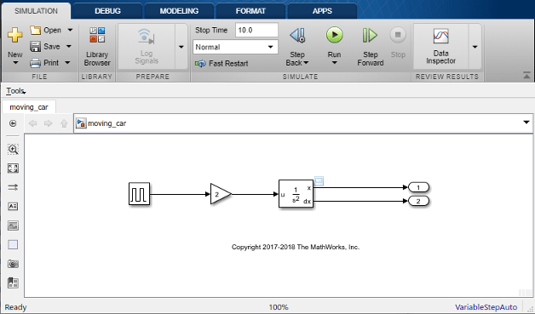
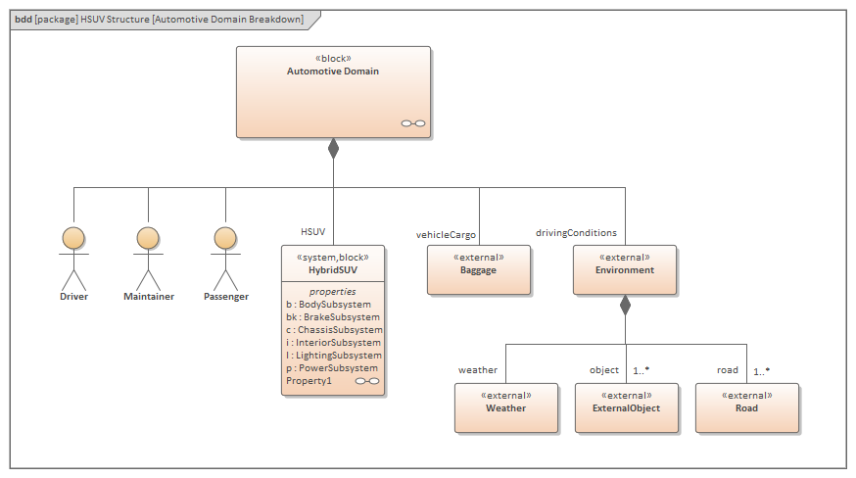
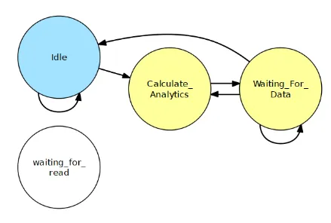
Interaction
Bond graph
Ode Simulink
SysML
State machine
Energy flow
control flow

Slide 17

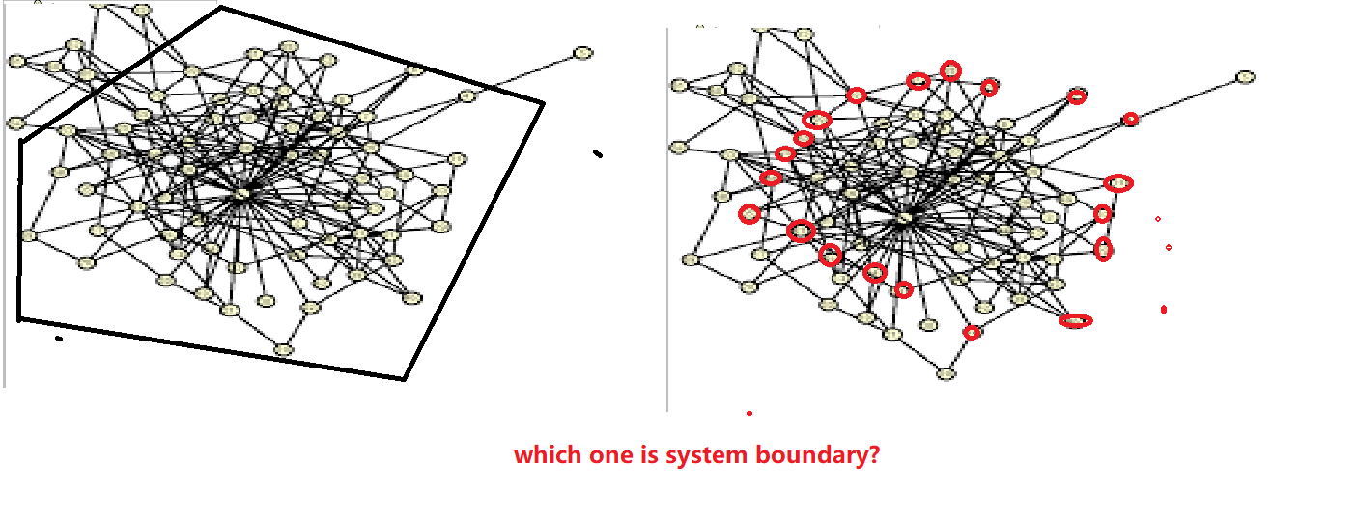


Software is important, can we develop another concepts on software? Then systems engineering working group focusing on physical system. Function is some type of information right?
System Boundary
System: Collection of elements in interaction. Definition applies to natural, social or technical systems.
System boundary is the collections of elements of the system which interact with entities which are not part of the system.
To define the system or system boundary, we require the selection of:
1 specific collections of elements
2 specific elements types
3 specific interaction types
4 specific outcome types (temp)
System? What is the
Boundary?
I love this system
Element and interaction?
Element in the context of the above discussion means certainly something physical, perhaps just means BFO object. Element?
Interaction in the context of the above discussion means how one element acts on other elements to have an effect on them?
Function is not an element
Some information entity?
Notes:
Definition of boundary by Hubka and Eder: The boundary of a technical system delimits its functioning unity, and must also be regarded as delimiting its spatial unity. At the surface of the TS there are boundary elements that mediate the connections to the environment, the inputs and outputs. These boundary elements are termed receptors and effectors, which contain the action sites of the technical system (where the TS exerts its effects or receives actions from outside). An interaction is a bidirectional relation between two objects. An element is the smallest part of a system, which cannot be split . An element is not a system. Human interactions are the least predictable!
Tod:
‘system boundary’ point(s) of interaction(s)?
One way to consider ‘boundary’ is with ‘respect to ‘responsibilities’. What is the entity responsible for?
An individual element of a system can have more than one ‘point’ of interaction.
In the definition of system, ‘collection of elements in interaction’, does ‘interaction’ refer to only interactions among the elements int collection (that constitutes the system)?
David: Agree with Barry's element argument. But we are doing Systems Engineering here - that does limit the type of system we consider.
Will:
Definition of verb "interact": to act in such a way as to have an effect on another; act reciprocally. [oxford languages]
From Ricardo Sanz to Everyone: 06:01 PM
An IOF ontology without software is useless.
From David Cameron to Everyone: 06:01 PM
SInce the analogue Control has become software.

Slide 18
Overview of Systems Engineering Principles
From Jinzhi Lu. A Framework for Cyber-physical System Tool-chain Development: A Service-oriented and Model-based Systems Engineering Approach. KTH PHD thesis
2

Slide 19
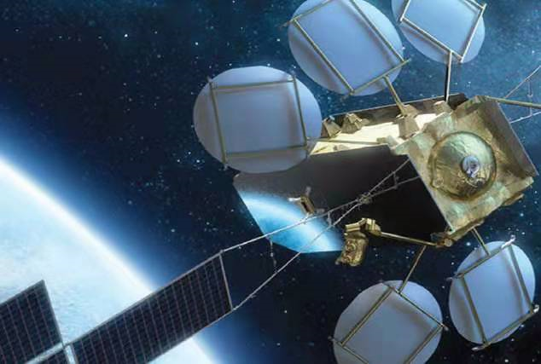
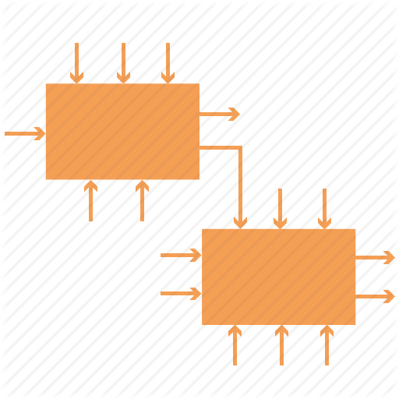
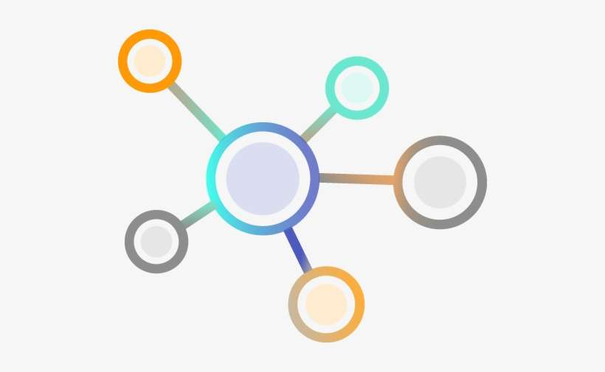
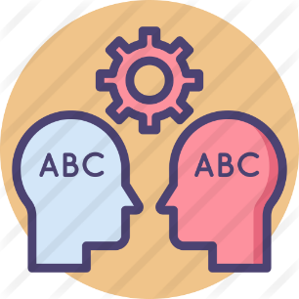

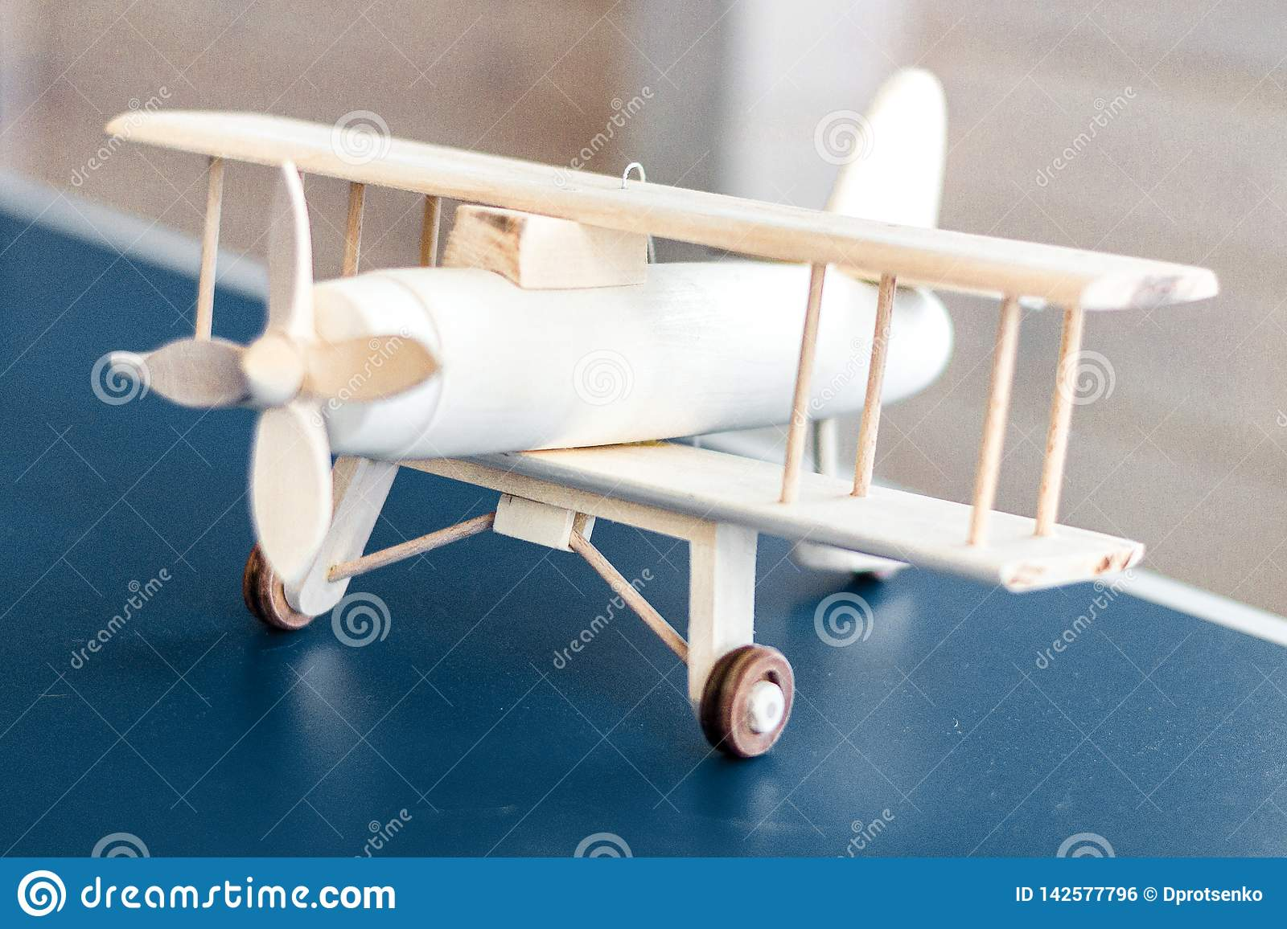
Why BFO ontology?
Where is ontology?
has
Abstract concepts (architecture)
Support
A physical system or a social system
Represent
System IN BFO
Information entity
Create
Model
Syntax with flaws
Without defining
Modeling languages
Stakeholder1
Syntax 2
Syntax 1
Physical model is another story, this model is not the same Model in the figure.
Required model 1
Required model 2
Stakeholder2
Syntax are conflicted which cannot describe the semantics in a right way

Slide 20
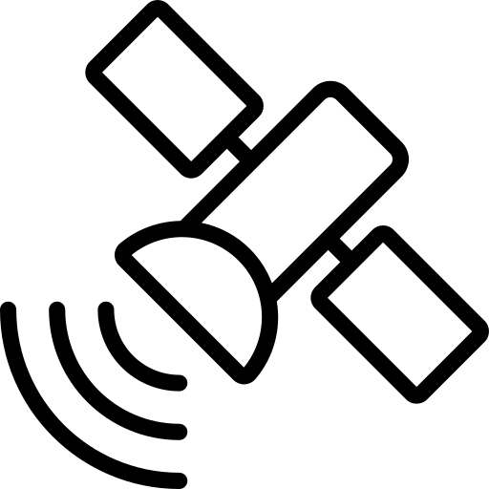
The problem of competing syntax
System IN BFO
Information entity
What is ontology for?
Without defining
Syntax 2
Required for model 2
has
A physical system instance
Represent
developed by using
instantiate
Modeling language
developed by using
Is used by
Represent
modeler
Is developed by
Model
Physical system universal

Slide 21
The problem of competing syntax
System IN BFO
Information entity
What is ontology for?
Without defining
Syntax 2
Required for model 2
has
A physical system instance
Represent
developed by using
instantiate
Modeling language
developed by using
has
Is used by
Represent
modeler
has
Is developed for
Physical system universal
thinks
Model
has
Perspective
represents
The description of System architecture
System architecture
Stakeholder
Concern
described
refines
Aspect
defines
has
has
View
Viewpoint
Uses

Slide 22
The problem of competing syntax
System IN BFO
Information entity
What is ontology for?
Without defining
Syntax 2
Required for model 2
has
A physical system instance
Represent
or specify
developed by using
instantiate
Modeling language
developed by using
Is used by
Represent or specify
Model
modeler
Is developed for
Physical system universal
hires
Interest in
Aspect
Is represented by
Stakeholder
thinks
Perspective

Slide 23
The problem of competing syntax
System IN BFO
Information entity
What is ontology for?
Without defining
Syntax 2
?
Required for model 2
has
Abstract or concept?
A physical system instance
Represent
developed by using
instantiate
Modeling language
developed by using
?
Is used by
Model
modeler
Is developed for
Physical system universal
hires
Interest in
Aspect
Is represented by
Stakeholder
thinks
Perspective

Slide 24
The problem of competing syntax
System IN BFO
Information entity
What is ontology for?
Without defining
Syntax 2
Required for model 2
has
A physical system instance
developed by using
Specify and represent
instantiate
Modeling language
developed by using
Specify and represent
Is used by
Model
modeler
Is developed for
Physical system universal
hires
Interest in
Aspect
Is represented by
Stakeholder
thinks
Perspective

Slide 25
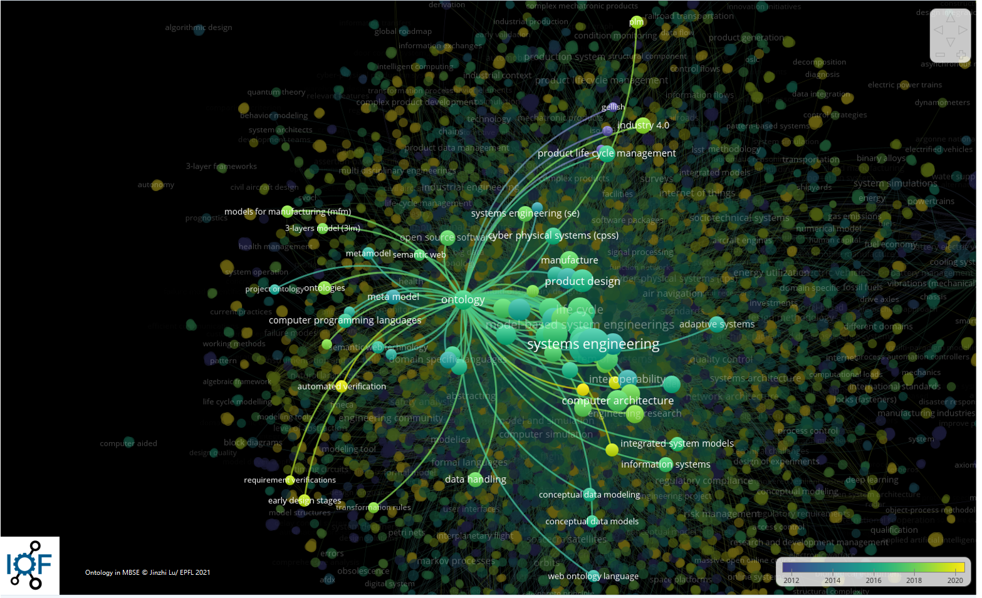

Slide 26

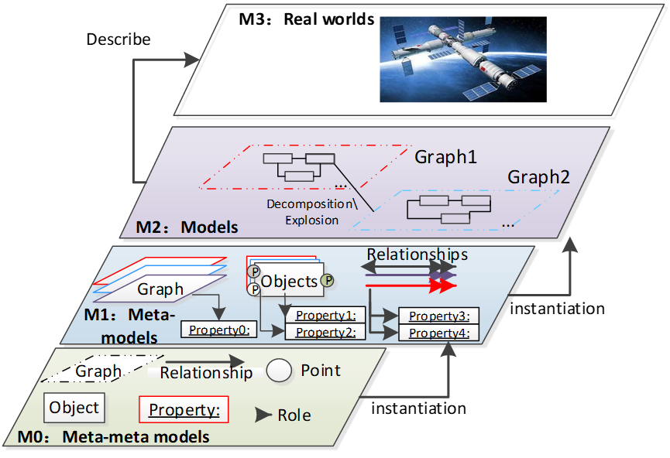

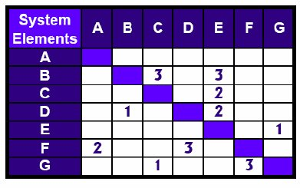
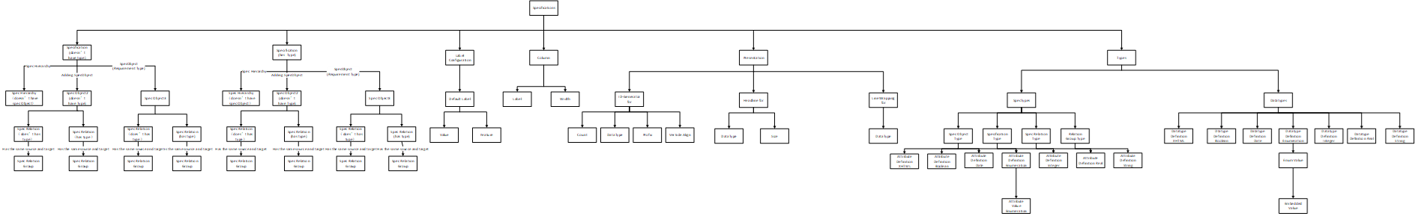
Progress in MBSE ontology
GOPPRR ontology for MBSE formalism
ReqIF requirement specification for requirement
Design structure matrix for traceability of requirement and MBSE formalisms (ongoing)
Bfo and IoF
In the summer, thanks for Z.K. Fengchao.
Lu J. Design Ontology Supporting Model-based Systems-engineering Formalisms. MODPROD [Internet]. 16Feb.2021 [cited 27Apr.2021];26(15):21. Available from: https://conference.ep.liu.se/index.php/MODPROD/article/view/723
https://www.researchgate.net/publication/4131294_Mapping_product_innovation_profile_to_product_development_activities_-_the_I-DSM_tool/figures?lo=1

Slide 27
Achievements
Three journals are under review:
Design Ontology Supporting Domain-specific Modeling Formalism based on a GOPPRR Approach
Co-Simulation of Complex Engineered Systems Enabled by a Cognitive Twin Architecture
Cognitive Twin Construction for System of Systems Operation based on Semantic Integration and High Level Architecture
Project progress:
AIRBUS may expect to develop a Cameo plugin for our ontology.

Slide 28
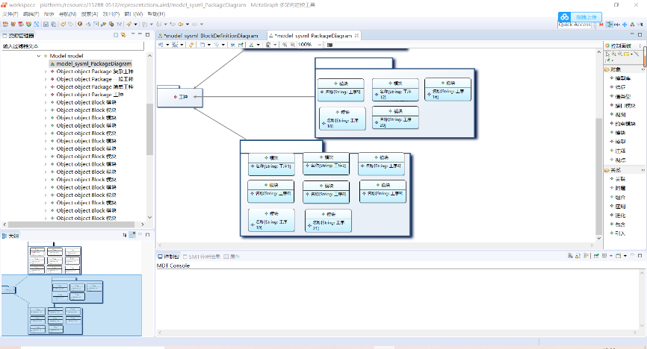
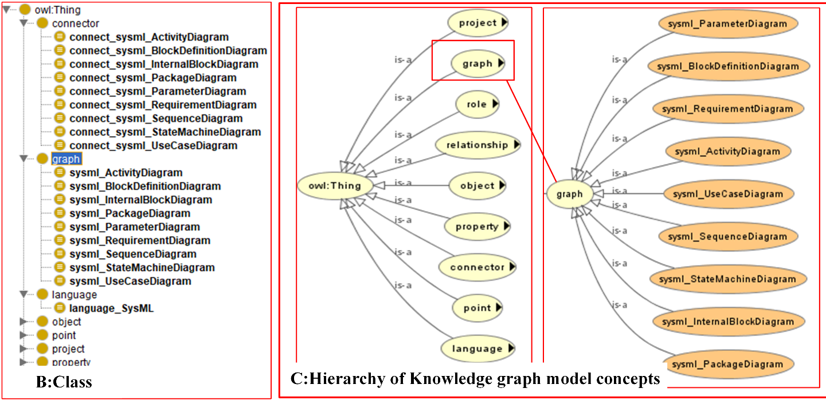
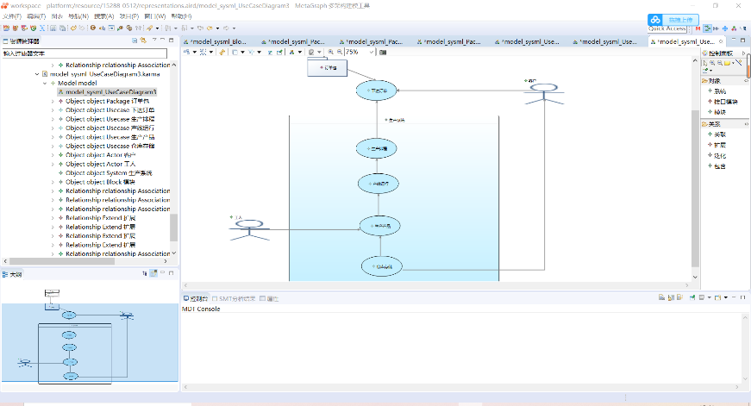
Ontology Modeling for SysML
Represents

Slide 29
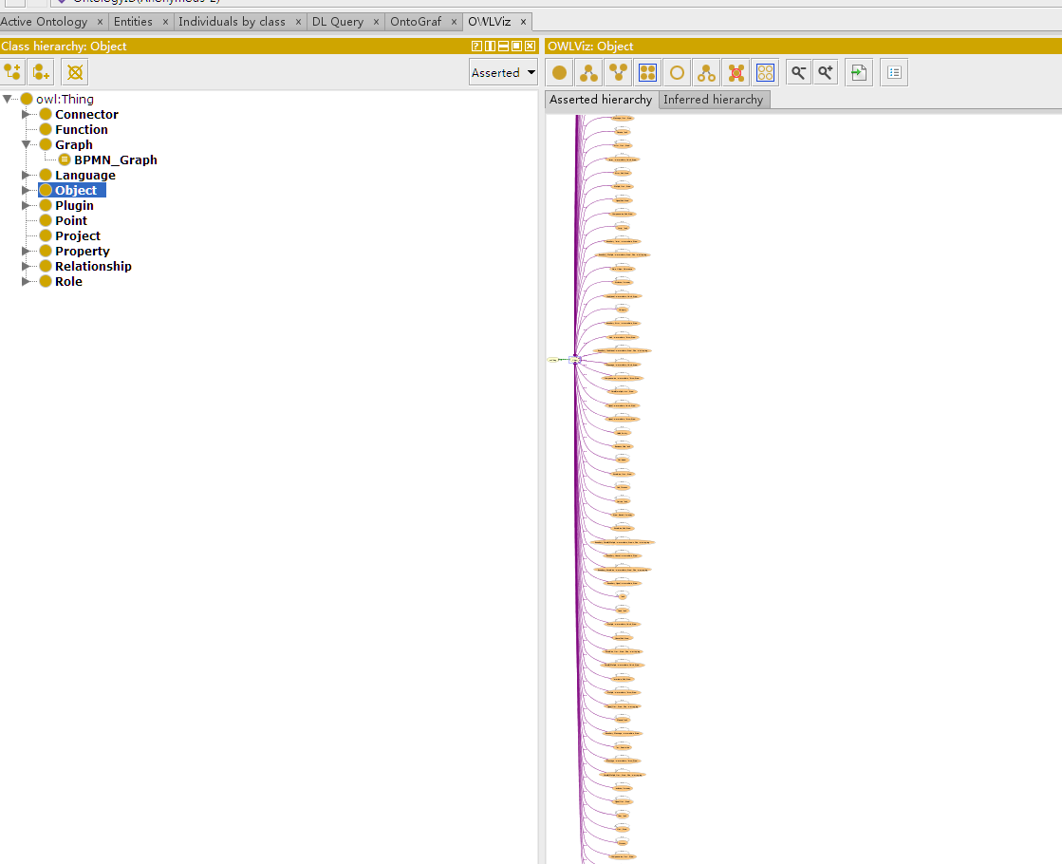
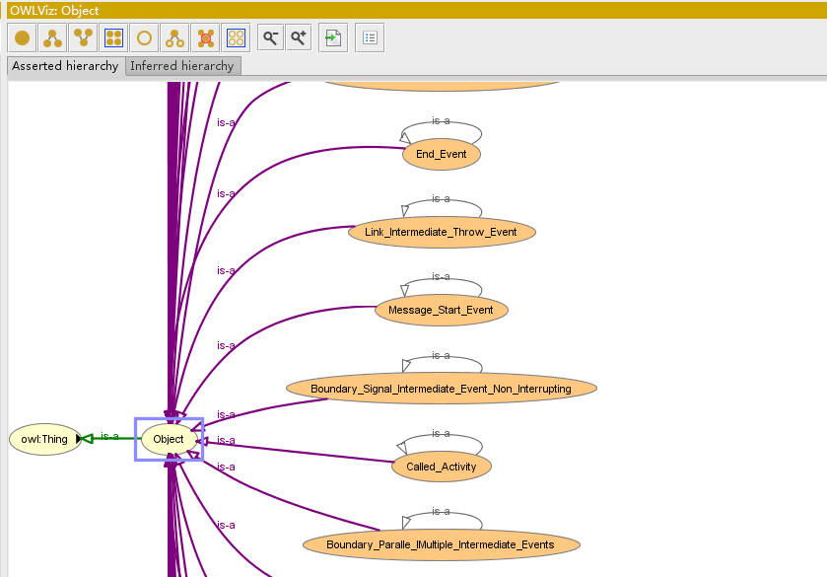
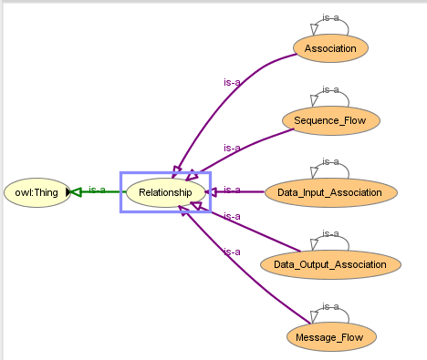
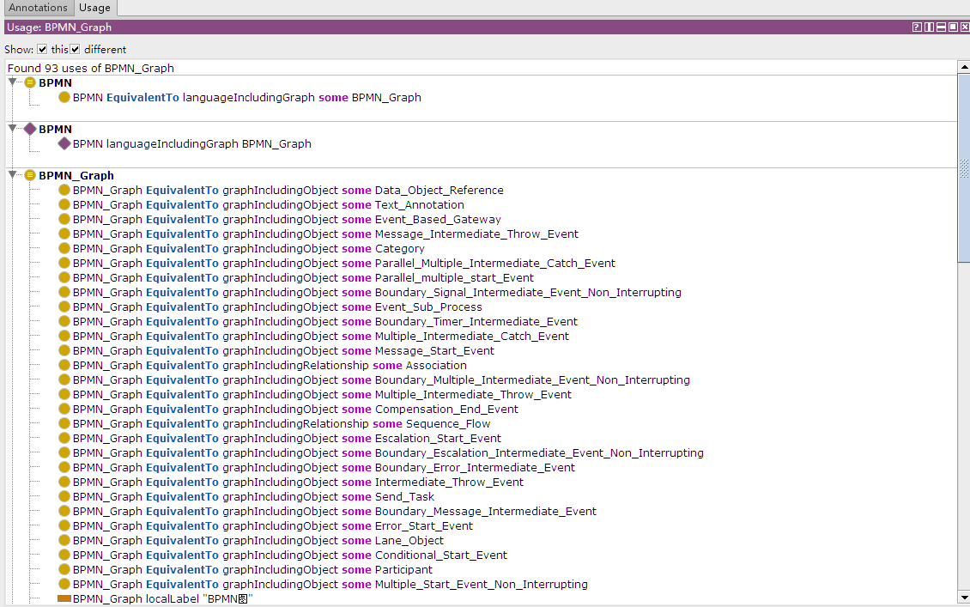
Ontology Modeling for BPMN
Represents
https://www.youtube.com/watch?v=LucfbAva37E

Slide 30
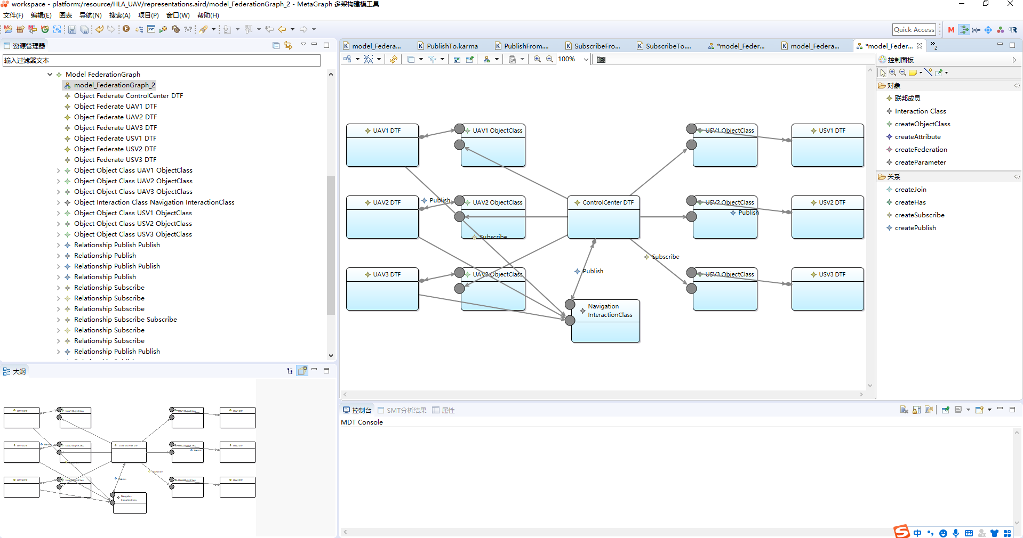
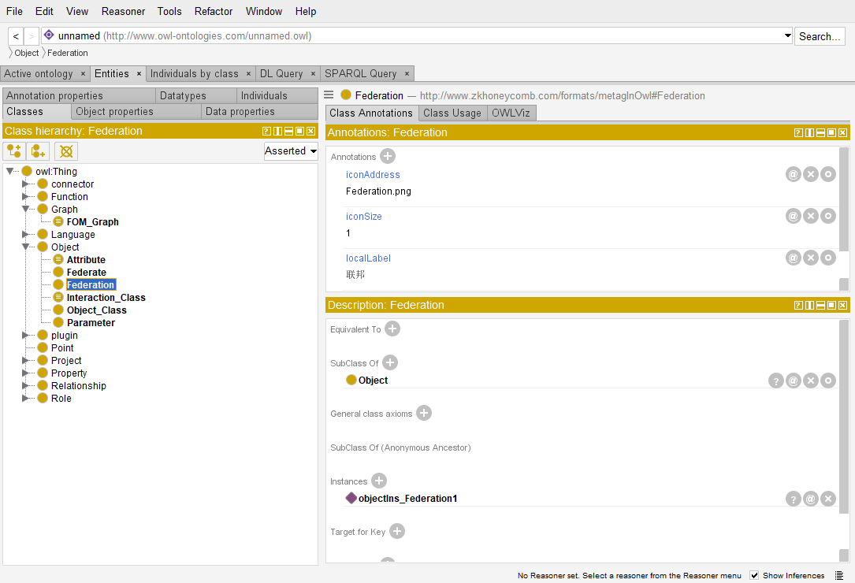
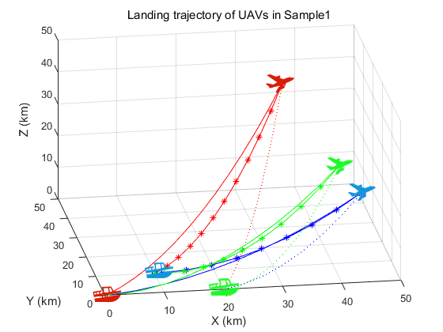
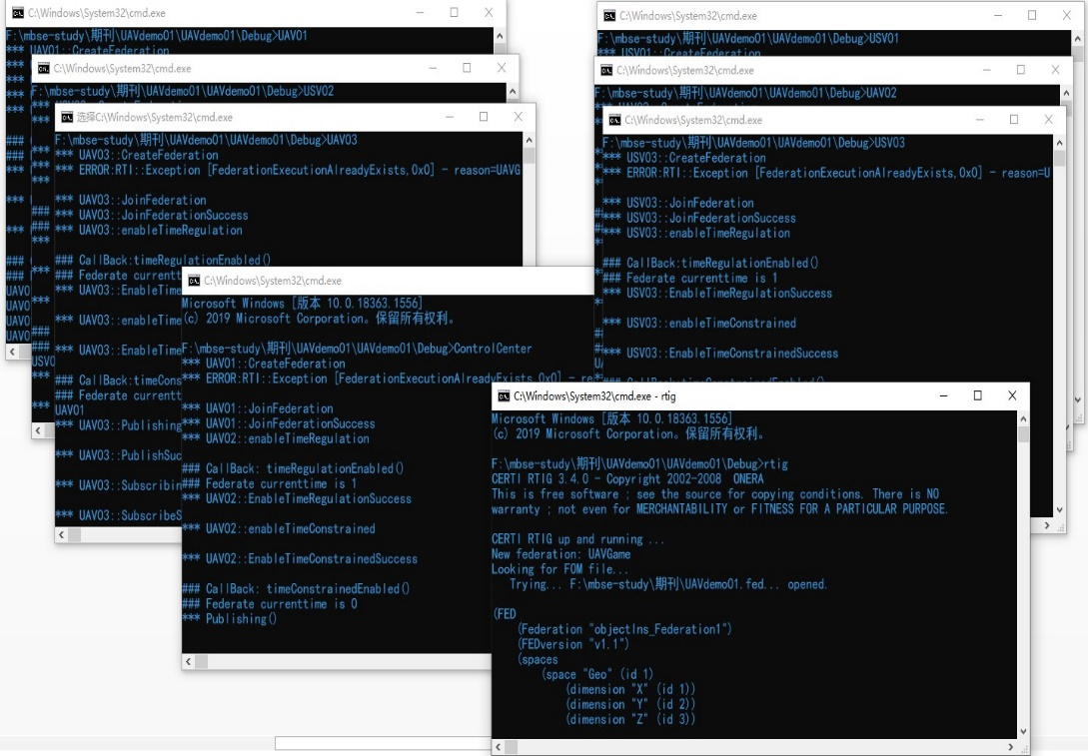
Ontology Modeling for HLA simulation
01
02
04
03

Slide 31
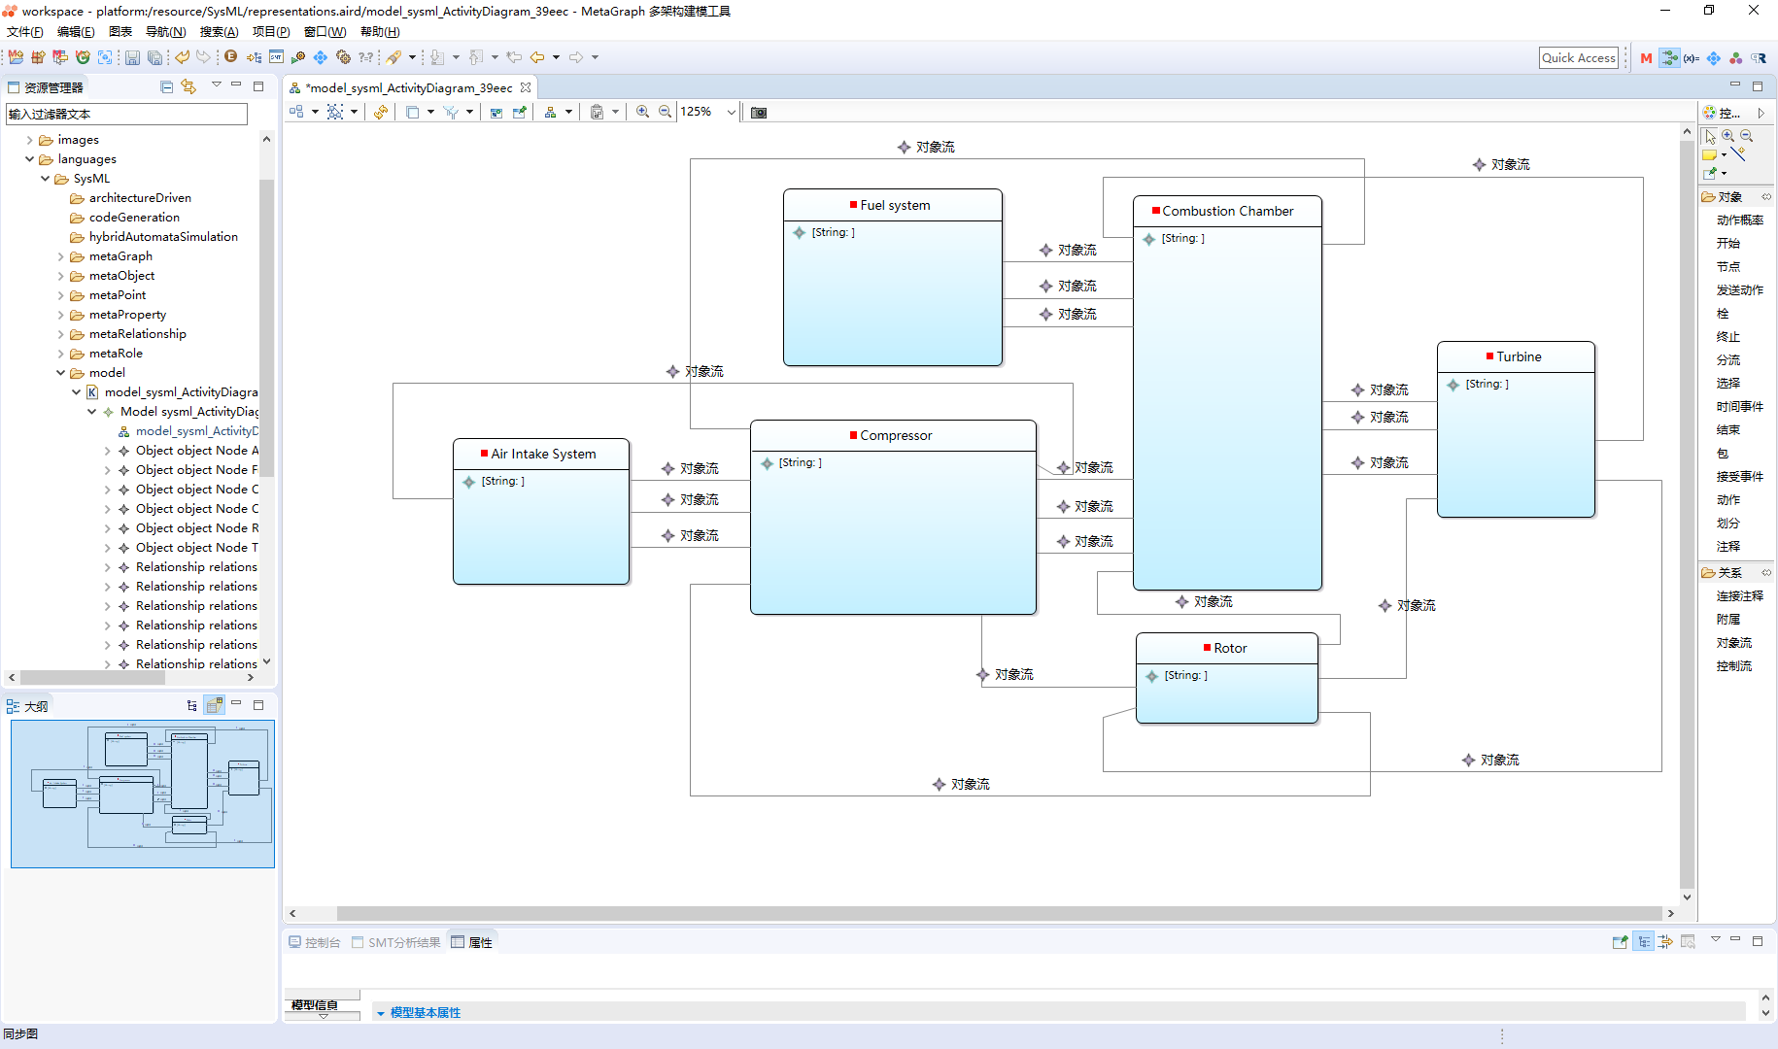
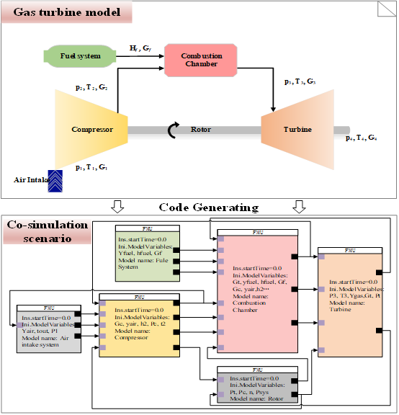
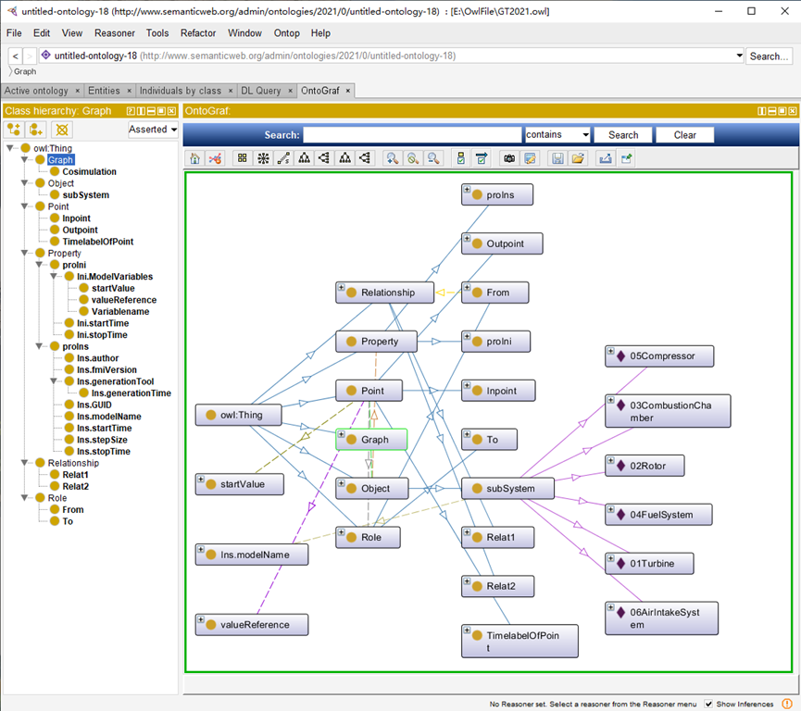
Ontology Modeling for co-simulation between FMUs
Co-simulation model
Represents
GOPPPRR model
Simulation Results
Ontology model

Slide 32
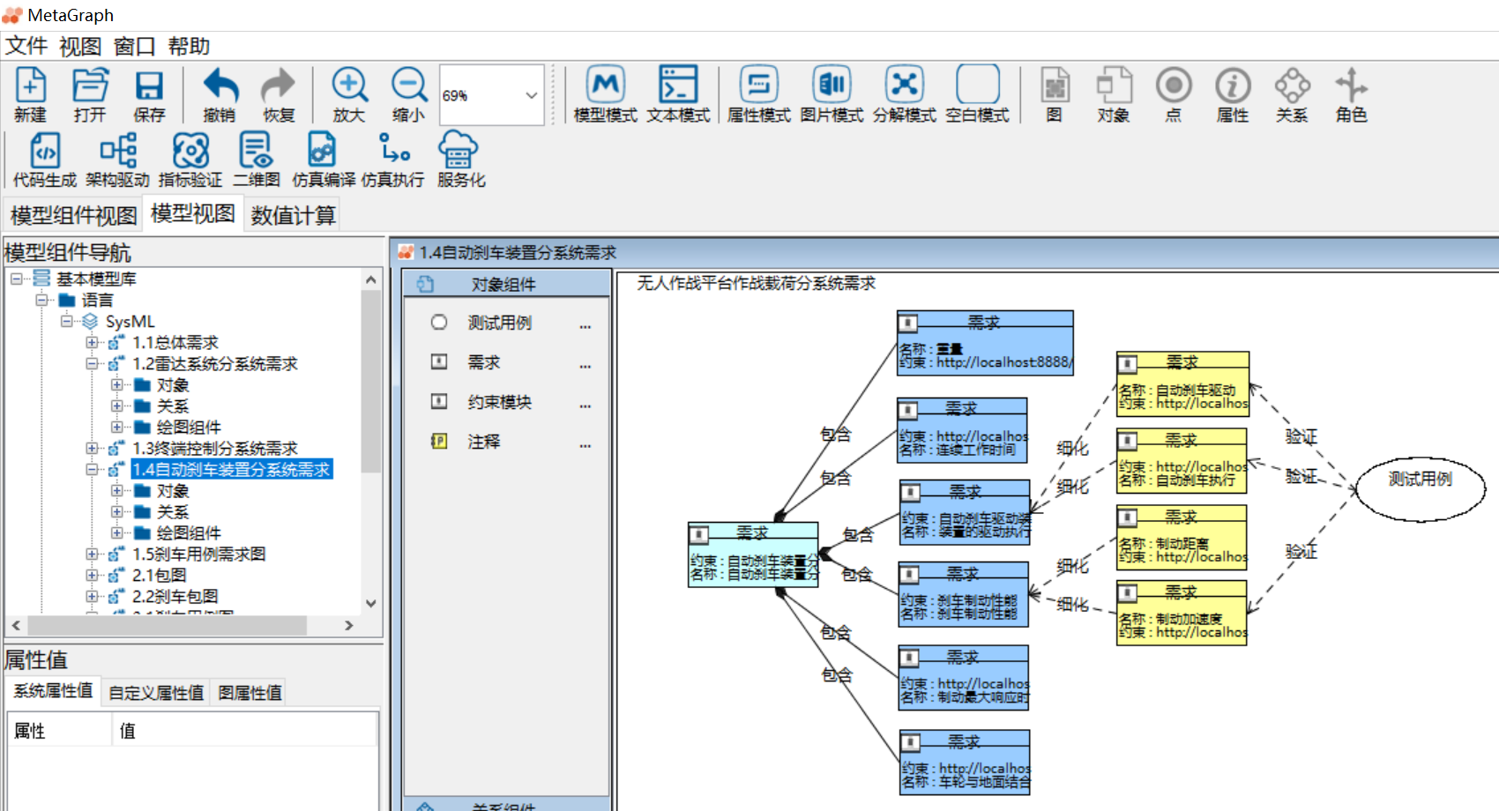
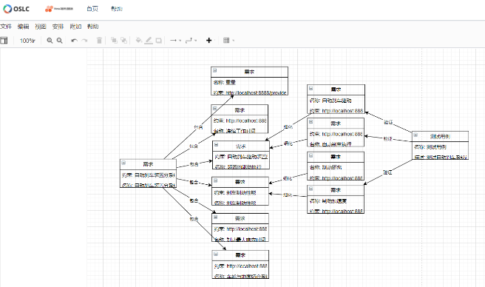
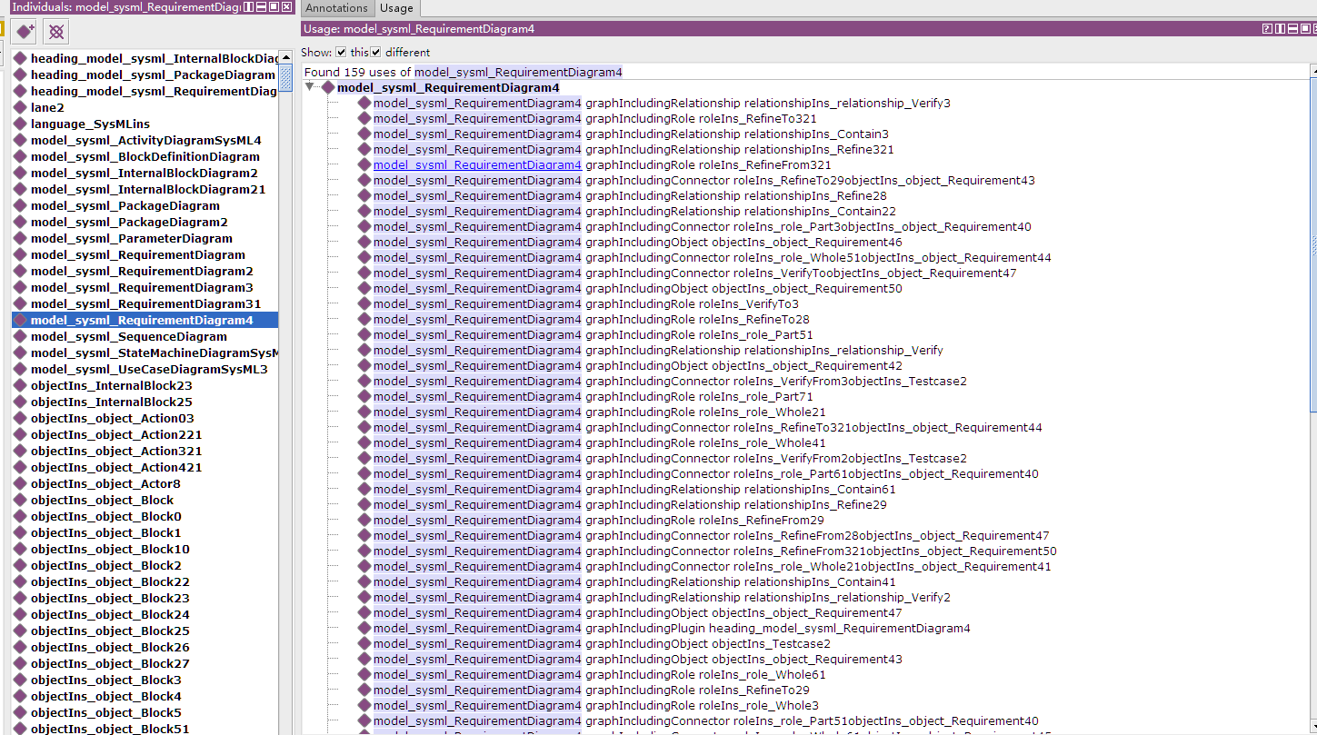
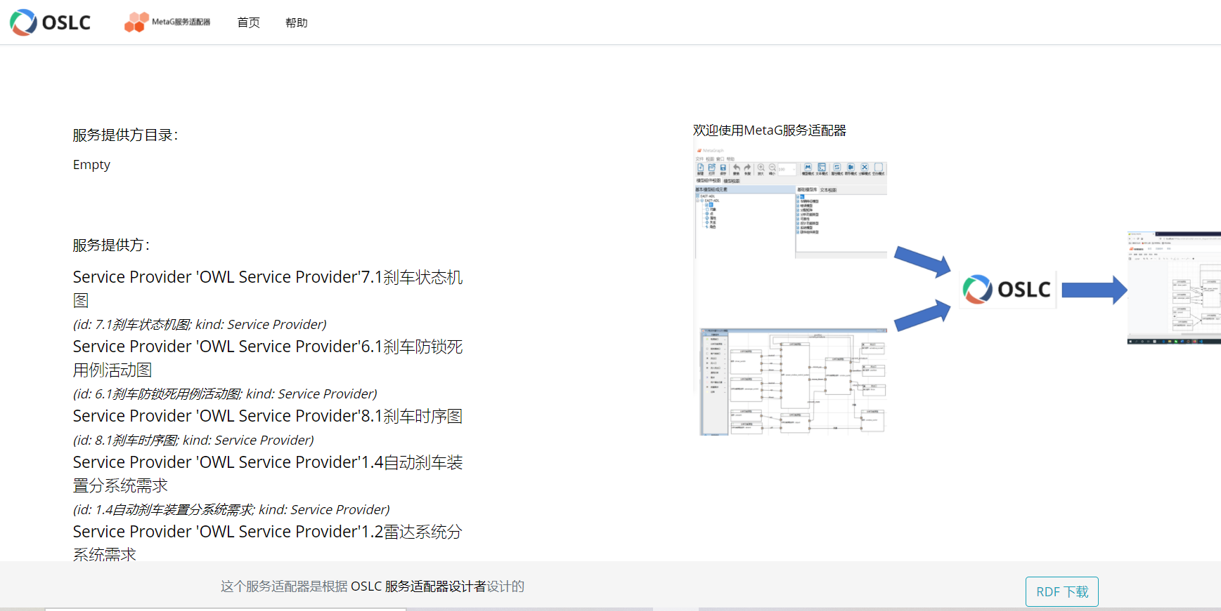
OSLC adaptor for GOPPRRE ontology (OPEN SOURCE)
Architecture Model
Model Visualization
OSLC adaptor:
JAVA interrupter
GOPPRR ontology in OWL
OSLC Services

Slide 33
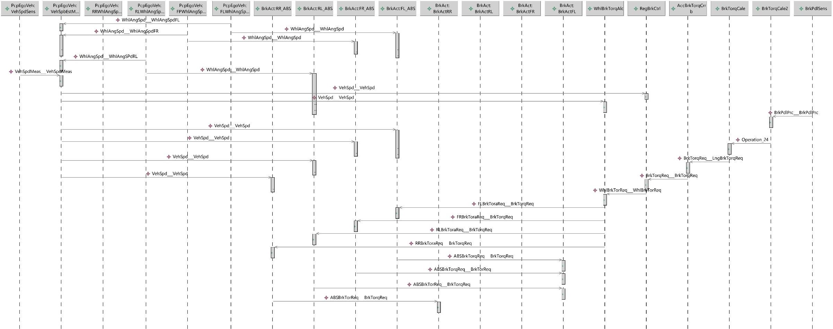
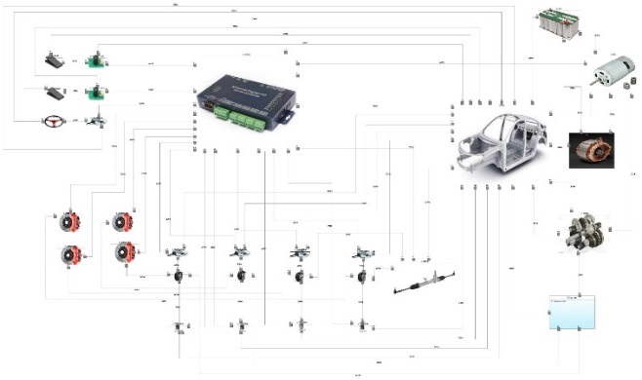
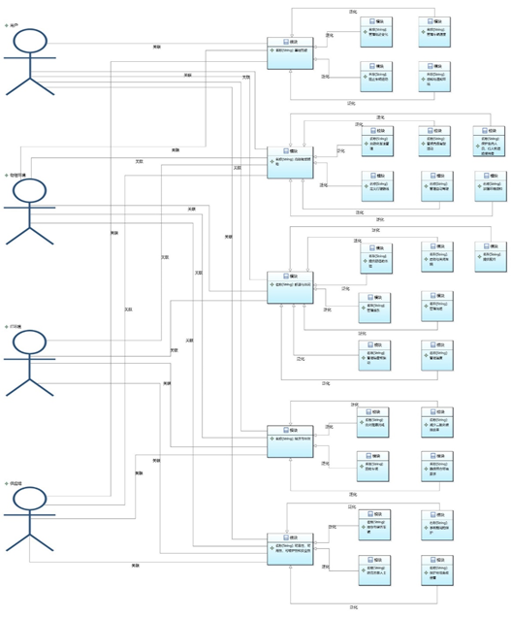
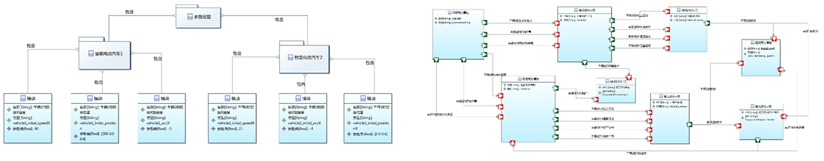
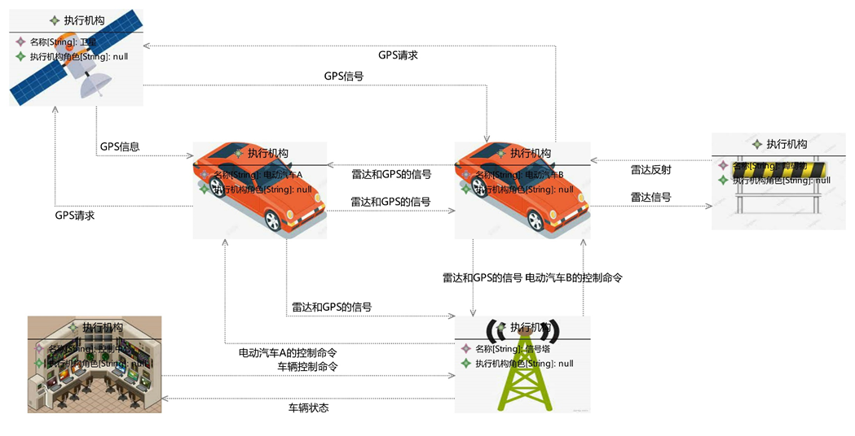
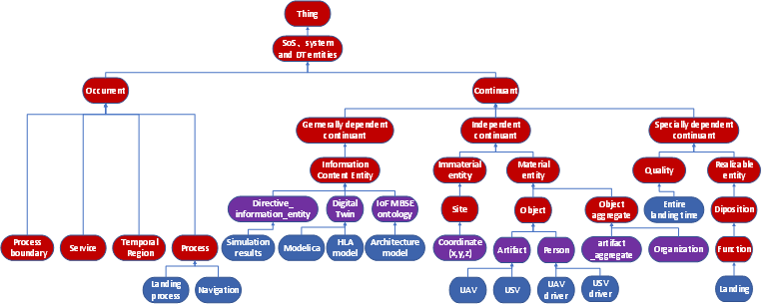
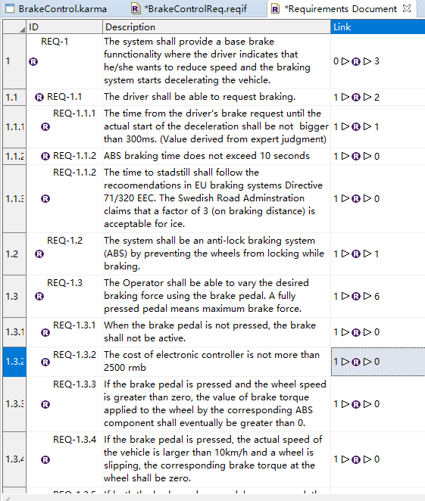
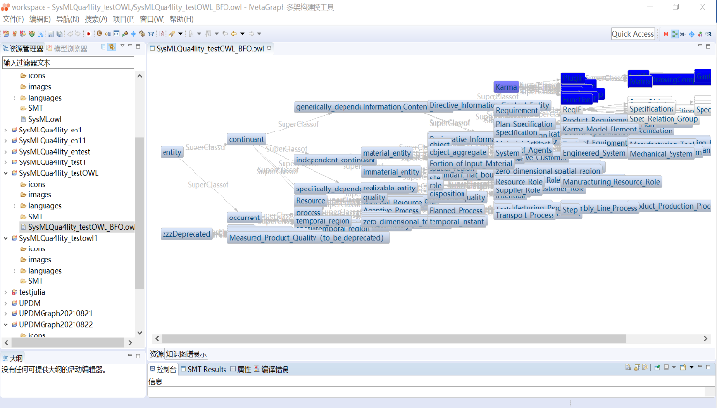
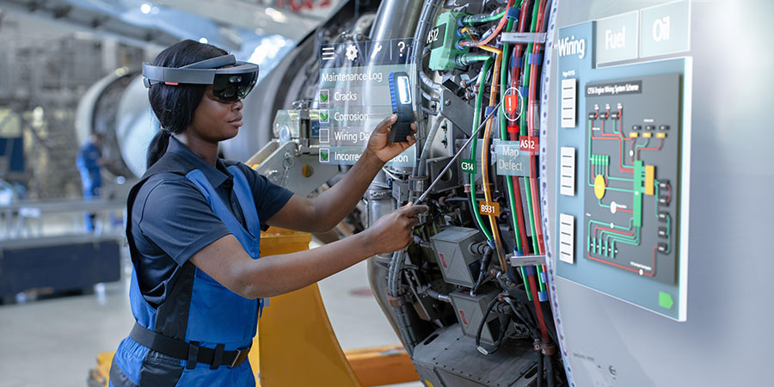
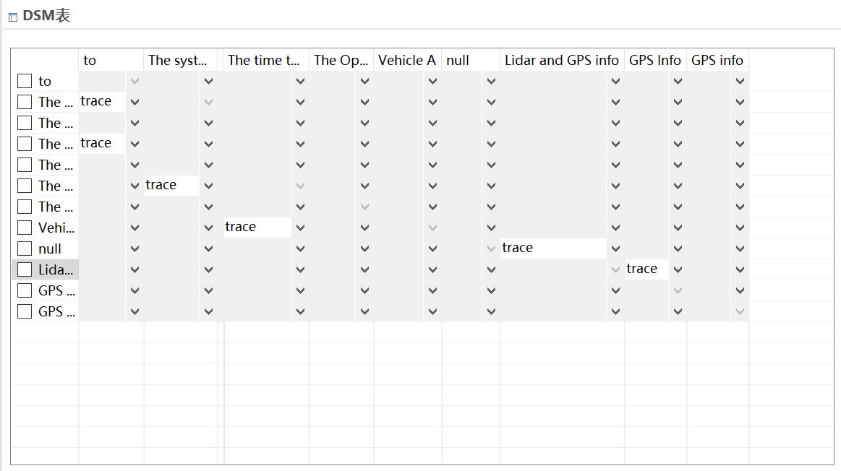
HUAWEI example for semantic MBSE
GOPPRRE model for HUAWEI autonomous driving system development
Generate
ReqIF requirement
? NEW PROPOSAL
FOR OTHER CASE
AR
Ontology model based on BFO
Design structure matrix

Slide 34
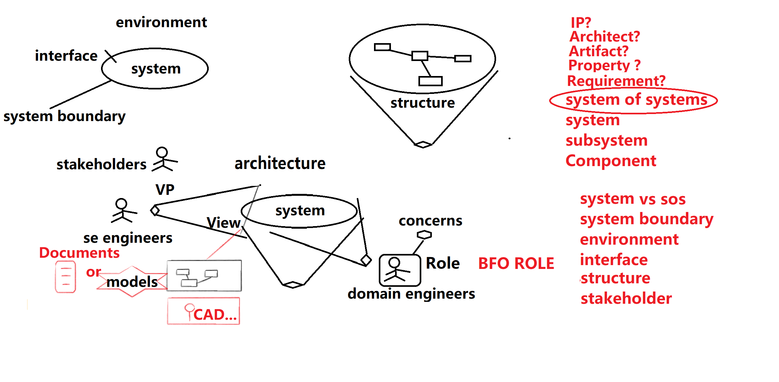
First plan and then testing
System function is viewpoint of system architecture

Slide 35
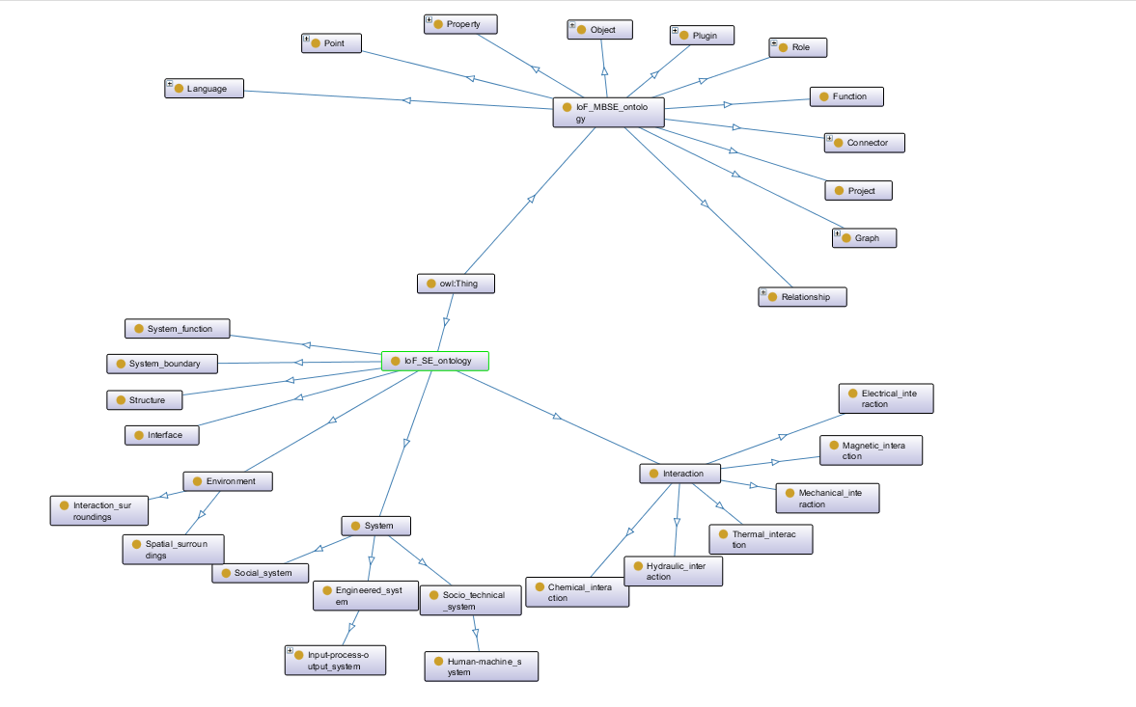

Slide 36
System
System: Collection of elements in interaction. Definition applies to natural, social or technical systems.
Engineered system: System which is designed to provide certain capabilities.
Input-process-output system : Engineered system whose function is to transform defined inputs into outputs
Production system: input-process-output system of which the defined output is a manufactured product.
Manufacturing system: input-process-output system of which the defined output is a manufactured artifact.
Social system: System whose elements are organisms.
Sociotechnical system: System whose elements include human-beings.
Human-machine system: Sociotechnical system whose elements include human-beings and machines.

Slide 37
System Function
System function :A function is a disposition that exists in virtue of the bearer‘s physical make-up and this physical make-up is something the bearer possesses because it came into being either through evolution (in the case of natural biological entities) or through intentional design (in the case of artefacts), in order to realize processes of a certain sort. （BFO and IoF）

Slide 38
Environment
Collection of elements that are not in the system, and are interacting with the system.
(environment refers to a high level class with two subclasses: 1. spatial surroundings, 2. interaction surroundings)
Notes:
Discussion
(1) is a system science definition and can be applied to any system.
(2) is an engineered system definition, and distinguishes between the different environments that exist during the life of a system.

Slide 39
System Boundary
System boundary is the collections of elements of the system which interact with entities which are not part of the system.
To define the system or system boundary, we require the selection of:
1 specific collections of elements
2 specific elements types
3 specific interaction types between elements
4 specific outcome types
5 specific interaction types between elements and
environment
Notes:
Definition of boundary by Hubka and Eder: The boundary of a technical system delimits its functioning unity, and must also be regarded as delimiting its spatial unity. At the surface of the TS there are boundary elements that mediate the connections to the environment, the inputs and outputs. These boundary elements are termed receptors and effectors, which contain the action sites of the technical system (where the TS exerts its effects or receives actions from outside). An interaction is a bidirectional relation between two objects. An element is the smallest part of a system, which cannot be split . An element is not a system. Human interactions are the least predictable!
In summary, a system Σ is an object denoted by a triplet (C, E and S) such that:
– card(C) > 1, which expresses the fact that Σ is composed of several parts (composite object);
– S = Sint ∪Sext with Sint≠∅, which expresses the fact that the endo-structure of Σ is not empty.
General Systems Theory 5
Figure 1.1. System composition, structure and environment
When E is empty, we say that the system Σ is a closed system. In the opposite case, we would say that this is an open system.
When its endo-structure Sint is empty, the object Σ is not a system; this is the case for fictitious stellar objects such as constellations. Ursa Major, unlike the galaxy M31 or the galaxy of Andromeda, is not a stellar system, whereas the stars that form it are themselves systems. Extracts from the Book of Micouin inspired by Mario Bunge
Tod:
‘system boundary’ point(s) of interaction(s)?
One way to consider ‘boundary’ is with ‘respect to ‘responsibilities’. What is the entity responsible for?
An individual element of a system can have more than one ‘point’ of interaction.
In the definition of system, ‘collection of elements in interaction’, does ‘interaction’ refer to only interactions among the elements int collection (that constitutes the system)?
David: Agree with Barry's element argument. But we are doing Systems Engineering here - that does limit the type of system we consider.
Will:
Definition of verb "interact": to act in such a way as to have an effect on another; act reciprocally. [oxford languages]
From Ricardo Sanz to Everyone: 06:01 PM
An IOF ontology without software is useless.
From David Cameron to Everyone: 06:01 PM
SInce the analogue Control has become software.

Slide 40
Interface
1. A shared boundary between two functional units, defined by various characteristics pertaining to the functions, physical signal exchanges, and other characteristics. (ISO/IEC 1993)
2. A hardware or software component that connects two or more other components for the purpose of passing information from one to the other. (ISO/IEC 1993)
3. To connect two or more components for the purpose of passing information from one to the other. (ISO/IEC/IEEE 2009)
Sources
From SEVOCAB (www.computer.org/sevocab):
(1) and (2) ISO/IEC. 1993. Information technology--Vocabulary--Part 1: Fundamental terms. Geneva, Switzerland: International Organization for Standardization (ISO)/International Electrotechnical Commission (IEC), ISO/IEC 2382-1:1993.
(3) ISO/IEC/IEEE. 2009. Systems and Software Engineering - System and Software Engineering Vocabulary (SEVocab). Geneva, Switzerland: International Organization for Standardization (ISO)/International Electrotechnical Commission (IEC)/ Institute of Electrical and Electronics Engineers (IEEE). ISO/IEC/IEEE 24765:2009.
Suggestion: Interactions which interact system boundary with the environment.
Interfaces: To exchange information, energy or material entities which
§ Interface is the site into which a connector is plugged / inserted
§ The connector is plugged into another interface in the other system
§ Retainer is a part of the system in a material sense, material entity that as a site into which a connector can be inserter
§ The connector has the function of allowing energy to be transmitted from one to the other
§ Connector: a material entity that has two ends that can be inserted into interfaces
HDMI case, radio waves, water pipe
System that exists?
Notes:
a relation between (status which) two collections of elements which acts on each others to have an effort on them.
In sysml diagram, interface is linking or element? David: Two ports implement an interface.
Interface in SysMl is about the structure or type of what we exchange through connected ports. Site is a good concept for this
We use fiat boundaries everywhere in our system breakdowns. But there is physical continuity across these boundaries. Connection?. It works also for pipes.

Slide 41
Interface
A boundary where interactions may occur.: Discuss in CORE WORKING GROUP
System
System Interface
interface
An element which is a part of the system boundary and has the function of interacting with entities outside the system.
Comment: The interaction occurs through the transfer of energy, matter, information and etc. Transfer means sending, receiving or both.
BFO ‘Function’: Elucidation) A function is a disposition that exists in virtue of the bearer's physical make-up and this physical make-up is something the bearer possesses because it came into being either through evolution (in the case of natural biological entities) or through intentional design (in the case of artefacts), in order to realize processes of a certain sort
Notes:
Definition of boundary by Hubka and Eder: The boundary of a technical system delimits its functioning unity, and must also be regarded as delimiting its spatial unity. At the surface of the TS there are boundary elements that mediate the connections to the environment, the inputs and outputs. These boundary elements are termed receptors and effectors, which contain the action sites of the technical system (where the TS exerts its effects or receives actions from outside). An interaction is a bidirectional relation between two objects. An element is the smallest part of a system, which cannot be split . An element is not a system. Human interactions are the least predictable!
In summary, a system Σ is an object denoted by a triplet (C, E and S) such that:
– card(C) > 1, which expresses the fact that Σ is composed of several parts (composite object);
– S = Sint ∪Sext with Sint≠∅, which expresses the fact that the endo-structure of Σ is not empty.
General Systems Theory 5
Figure 1.1. System composition, structure and environment
When E is empty, we say that the system Σ is a closed system. In the opposite case, we would say that this is an open system.
When its endo-structure Sint is empty, the object Σ is not a system; this is the case for fictitious stellar objects such as constellations. Ursa Major, unlike the galaxy M31 or the galaxy of Andromeda, is not a stellar system, whereas the stars that form it are themselves systems. Extracts from the Book of Micouin inspired by Mario Bunge
Tod:
‘system boundary’ point(s) of interaction(s)?
One way to consider ‘boundary’ is with ‘respect to ‘responsibilities’. What is the entity responsible for?
An individual element of a system can have more than one ‘point’ of interaction.
In the definition of system, ‘collection of elements in interaction’, does ‘interaction’ refer to only interactions among the elements int collection (that constitutes the system)?
David: Agree with Barry's element argument. But we are doing Systems Engineering here - that does limit the type of system we consider.
Will:
Definition of verb "interact": to act in such a way as to have an effect on another; act reciprocally. [oxford languages]
From Ricardo Sanz to Everyone: 06:01 PM
An IOF ontology without software is useless.
From David Cameron to Everyone: 06:01 PM
SInce the analogue Control has become software.
Connector = (def) a thing that links two or more things together

Slide 42
S1
System interface
S2
System Interface
S1
S2
S3
S1 and S2
S2 and S3
S1, S2 and S3
S3
Interaction
interface
S4
System: s2 or s1, system boundary
An element which is a part of the system boundary and has the function of interacting with entities outside the system.
Comment: The interaction occurs through the transfer of energy, matter, information and etc. Transfer means sending, receiving or both.
BFO ‘Function’: Elucidation) A function is a disposition that exists in virtue of the bearer's physical make-up and this physical make-up is something the bearer possesses because it came into being either through evolution (in the case of natural biological entities) or through intentional design (in the case of artefacts), in order to realize processes of a certain sort
Notes:
Definition of boundary by Hubka and Eder: The boundary of a technical system delimits its functioning unity, and must also be regarded as delimiting its spatial unity. At the surface of the TS there are boundary elements that mediate the connections to the environment, the inputs and outputs. These boundary elements are termed receptors and effectors, which contain the action sites of the technical system (where the TS exerts its effects or receives actions from outside). An interaction is a bidirectional relation between two objects. An element is the smallest part of a system, which cannot be split . An element is not a system. Human interactions are the least predictable!
In summary, a system Σ is an object denoted by a triplet (C, E and S) such that:
– card(C) > 1, which expresses the fact that Σ is composed of several parts (composite object);
– S = Sint ∪Sext with Sint≠∅, which expresses the fact that the endo-structure of Σ is not empty.
General Systems Theory 5
Figure 1.1. System composition, structure and environment
When E is empty, we say that the system Σ is a closed system. In the opposite case, we would say that this is an open system.
When its endo-structure Sint is empty, the object Σ is not a system; this is the case for fictitious stellar objects such as constellations. Ursa Major, unlike the galaxy M31 or the galaxy of Andromeda, is not a stellar system, whereas the stars that form it are themselves systems. Extracts from the Book of Micouin inspired by Mario Bunge
Tod:
‘system boundary’ point(s) of interaction(s)?
One way to consider ‘boundary’ is with ‘respect to ‘responsibilities’. What is the entity responsible for?
An individual element of a system can have more than one ‘point’ of interaction.
In the definition of system, ‘collection of elements in interaction’, does ‘interaction’ refer to only interactions among the elements int collection (that constitutes the system)?
David: Agree with Barry's element argument. But we are doing Systems Engineering here - that does limit the type of system we consider.
Will:
Definition of verb "interact": to act in such a way as to have an effect on another; act reciprocally. [oxford languages]
From Ricardo Sanz to Everyone: 06:01 PM
An IOF ontology without software is useless.
From David Cameron to Everyone: 06:01 PM
SInce the analogue Control has become software.
Connector = (def) a thing that links two or more things together

Slide 43
ROLE: Subsystem role
A subsystem is a proper part of a system which is itself a system.
A subsystem cannot exist as a subsystem by itself.
System of systems is a collection of systems which is itself a system.
Decompose into a class?
System of systems

Slide 44
Super system S1
S1
Relational quality decomposition
Sub system S11 role
S11
S12
Super system S11
S111
S112
environment
Sub system S111 role
Sub system S12
Relational quality xxy
Sub system S112

Slide 45


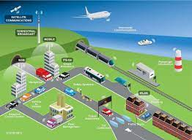

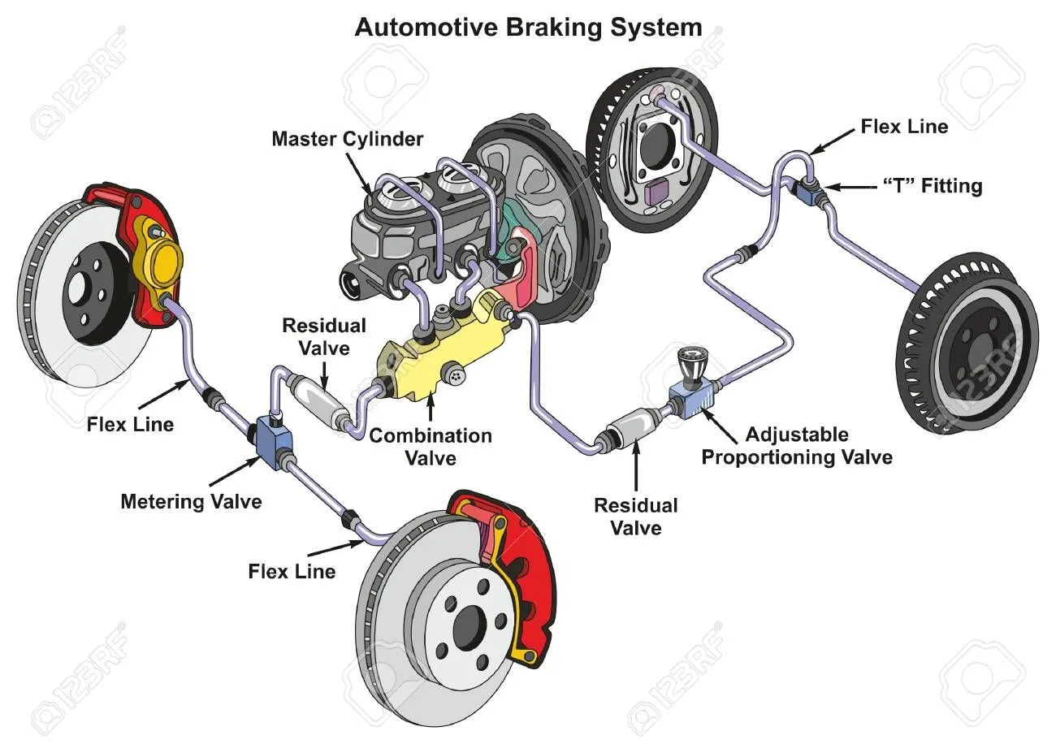
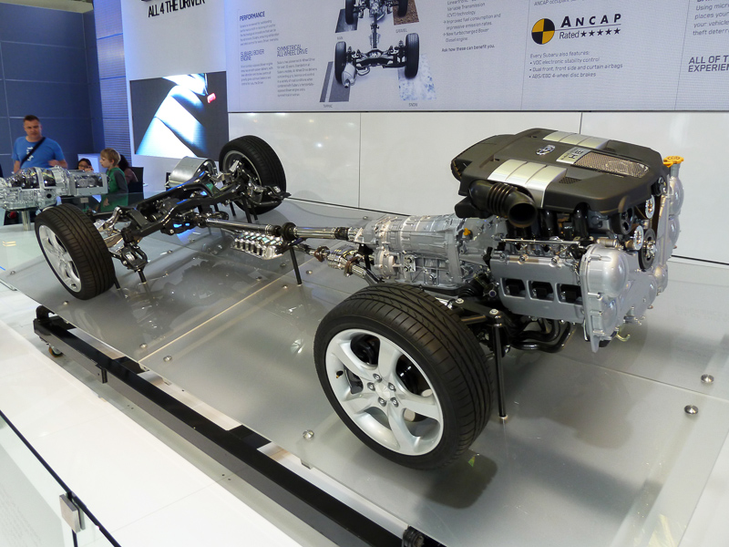

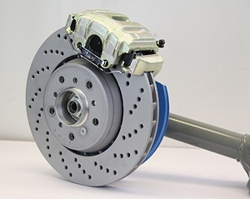
satellite
System of systems
sun
V2I infrastructure
Object property: hasPart
Has
A Part of
Has part
environment
BMW
Relational quality decomposition
Subsystem S11 role
hasPart
system role S11
Braking system
Power train
brake pad
brake pedal
environment
Sub system S111 role
Sub system S112
Sub system S12

Slide 46

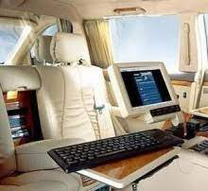
Each BMW has the supersystem role relative to some braking system, some power train system, and so on. The letters then have the subsystem role relative to the BMW.
satellite
Operates_within
System of systems
sun
rain
V2I infrastructure
Operates_within
Environment of BMW
When BMW is system, it has a subsystem::braking system whose subsystem is brake pad.
The braking system has a subsystem:: brake pad. (the braking system is considered as a system)
System role
Supersystem role
plays
BMW
has_Assembled_Part
Context class
Subsystem role
has_Assembled_Part
is role of
Braking system
Power train
In-Vehicle entertainment system
has_Assembled_Part
Instance: context
Engine id:
The subsystem and supersystem pattern involves a untransitive relationships.
brake pad
brake pedal
List some functional aspects, viewpoints, views?
Product,location?
CONTEXT similar to viewpoint or view is required.
Aspects? Aspect
aspect
specified way of viewing an object (3.1)
4.2 Aspect
If the elements of an object or the interrelations of this object to other objects are to be studied, it is useful to look at these objects from different views. For the purpose of this document, these views are called aspects.
The aspect concept is, in this document, used for structuring purposes.
Viewing an object using an aspect, only occurrences of sub-objects that are relevant in that aspect are visible.
When an object is recognized within an aspect, all the information related to that object may be accessed, including information on its other aspects, if any.

Slide 47
satellite
Operates_within
sun
rain
include
include
Environment of BMW
V2I infrastructure
subclass
Operates_within
Role
has
Supersystem role
plays
BMW
has_Assembled_Part
subclass
Subsystem role
has_Assembled_Part
is role of
Braking system
Power train
In-Vehicle entertainment system
has_Assembled_Part
brake pad
brake pedal
System A is the subsystem of System B
System B has_Assembled_Part System A which has a role of subsystem role.
Context is not considered right now.

Slide 48

A viewpoint is a specification of the conventions and rules for constructing and using a view for the purpose of addressing a set of stakeholder concerns (OMG 2010)
Architecture viewpoint: work product establishing the conventions for the construction, interpretation and use of architecture views to frame specific system concerns (ISO IEEE 42010).
Viewpoint:
Source(s)
1. OMG. 2010. OMG Systems Modeling Language (OMG SysML™), Version 1.3. Needham, MA, USA: Object Management Group. Available at http://www.omg.org/technology/documents/domain_spec_catalog.htm#OMGSysML - derived from IEEE 1471.
2. IEEE Standard (2011) INTERNATIONAL STANDARD ISO / IEC / IEEE Systems and software engineering - Architecture description
View is A representation of a system from the perspective of a viewpoint. (OMG 2010)
Architecture view: work product expressing the architecture of a system from the perspective of specific system concerns (ISO IEEE 42010)
View: a view of a system from a given aspect focuses on those features of the system which are defined by the aspect.
A view is a projection of a system architecture
Sources
1.OMG. 2010. OMG Systems Modeling Language (OMG SysML™), Version 1.3. Needham, MA, USA: Object Management Group. Accessed on 11 September 2012. Available at http://www.omg.org/technology/documents/domain_spec_catalog.htm#OMGSysML - derived from IEEE 1471.
2. IEEE Standard (2011) INTERNATIONAL STANDARD ISO / IEC / IEEE Systems and software engineering - Architecture description
https://www.slideshare.net/dJdU/all-about-isoiecieee-42010-2014r5?from_action=save
Aspect= viewpoint
If the elements of an object or the interrelations of this object to other objects are to be studied, it is useful to look at these objects from different views. For the purpose of this document, these views are called aspects.
The aspect concept is, in this document, used for structuring purposes.
Viewing an object using an aspect, only occurrences of sub-objects that are relevant in that aspect are visible.
When an object is recognized within an aspect, all the information related to that object may be accessed, including information on its other aspects, if any.

Slide 49
Description of the hierarchy
Natural system in environment
BMW is a part of V2I infrastructure
SoS has a part as BMW.
System of systems
V2I infrastructure
sun
Has
Sun is the environment of Vehicle to Infrastructure SoS.
BMW is a part of Vehicle to Infrastructure SoS.
BMW has braking system and power train system as sub system.
The braking system has brake pads and brake pedal as sub-system
Super system S1
BMW
Relational quality decomposition
Sub system S11 role
Super system S11
Braking system
Power train
brake pads
brake pedal
Sub system S111 role
Relational quality xxy
Sub system S12
environment
Sub system S112

Slide 50
system S1 role
S1
Relational quality decomposition
Sub system S11 role
S11
S12
Super system S11
S111
S112
environment
Sub system S111
Sub system S12
Relational quality xxy
Sub system S112

Slide 51
Super system S1
S1
Relational quality xxx
Sub system S11
S11
S12
Super system S11
S111
S112
environment
Sub system S111
Sub system S12
Relational quality xxy
Sub system S112

Slide 52
Interface for material entity
Interface for Engineered system
Interface for software
Interface for information
Interface for evolved natural system , such as biological organism, which
Interface for Natural system
Interface for multi-waves
Interface for liquid
Interface for gas
Interface for biological system

Slide 53
Retainer
Connector
Interface for material entity
interface
Interface is the site into which a connector is joined, used to transfer energy, material entities, etc.(Comments) interface should have direction
The connector refers to a material entity that has two ends that can be inserted into interfaces in the other system.
The retainer is a part of the system in as a material entity that as a site into which a connector can be inserted.
Connector
Retainer
User interface
The user interface (UI) is the point of human-computer interaction and communication in a device.
Notes:
Definition of boundary by Hubka and Eder: The boundary of a technical system delimits its functioning unity, and must also be regarded as delimiting its spatial unity. At the surface of the TS there are boundary elements that mediate the connections to the environment, the inputs and outputs. These boundary elements are termed receptors and effectors, which contain the action sites of the technical system (where the TS exerts its effects or receives actions from outside). An interaction is a bidirectional relation between two objects. An element is the smallest part of a system, which cannot be split . An element is not a system. Human interactions are the least predictable!
In summary, a system Σ is an object denoted by a triplet (C, E and S) such that:
– card(C) > 1, which expresses the fact that Σ is composed of several parts (composite object);
– S = Sint ∪Sext with Sint≠∅, which expresses the fact that the endo-structure of Σ is not empty.
General Systems Theory 5
Figure 1.1. System composition, structure and environment
When E is empty, we say that the system Σ is a closed system. In the opposite case, we would say that this is an open system.
When its endo-structure Sint is empty, the object Σ is not a system; this is the case for fictitious stellar objects such as constellations. Ursa Major, unlike the galaxy M31 or the galaxy of Andromeda, is not a stellar system, whereas the stars that form it are themselves systems. Extracts from the Book of Micouin inspired by Mario Bunge
Tod:
‘system boundary’ point(s) of interaction(s)?
One way to consider ‘boundary’ is with ‘respect to ‘responsibilities’. What is the entity responsible for?
An individual element of a system can have more than one ‘point’ of interaction.
In the definition of system, ‘collection of elements in interaction’, does ‘interaction’ refer to only interactions among the elements int collection (that constitutes the system)?
David: Agree with Barry's element argument. But we are doing Systems Engineering here - that does limit the type of system we consider.
Will:
Definition of verb "interact": to act in such a way as to have an effect on another; act reciprocally. [oxford languages]
From Ricardo Sanz to Everyone: 06:01 PM
An IOF ontology without software is useless.
From David Cameron to Everyone: 06:01 PM
SInce the analogue Control has become software.
Connector = (def) a thing that links two or more things together

Slide 54
Interface for software
Software interface (programming interfaces) are the languages, codes and messages that programs use to communicate with each other and to the material entity. Examples are the Windows, Mac and Linux operating systems, SMTP email, IP network protocols and the software drivers that activate the peripheral devices.
https://www.pcmag.com/encyclopedia/term/interface
Interface for information
Such as interface in sysml
An information entity which represents the a part of the system boundary and which has a function of and interacts with entities outside the system through the transfer of energy, matter, information and other media.

Slide 55




Interface for multi-waves
a part of the system boundary and which has a function of and interacts with entities outside the system through the transfer of multi-waves.
If the multi-wares are material entity? NO
Energy, wave, water
Connector
Retainer
Interface for liquid
a part of the system boundary and which has a function of and interacts with entities outside the system through the transfer of liquid.

Slide 56
Interface for gas
a part of the system boundary and which has a function of and interacts with entities outside the system through the transfer of gas.
Interface for biological system
a part of the system boundary and which has a function of and interacts with entities outside the system through the transfer of biological system.

Slide 57
Interaction
Interaction has two meanings: (1) A process in which two elements acts on each other by changing their qualities.
Mechanical interaction: The mechanical interaction can be characterized by mechanical impedance, which seeks to establish a dynamic relationship between an output force and an input trajectory, using dynamic properties, such as stiffness, damping, and inertia.
(https://www.sciencedirect.com/topics/engineering/mechanical-interaction)
Hydraulic interaction:
Chemical interaction:
Electrical interaction:
Magnetic interaction: Magnetic interactions are important for certain classes of materials that are of technological importance today, ranging from magnaflux devices used to detect cracks to magnetic recording materials to magnetic carriers used in electrophotographic engines to charge and transport the toner particles.
Thermal interaction:
State: at some time point, the quality of the system
stasis:
Notes:
Definition of boundary by Hubka and Eder: The boundary of a technical system delimits its functioning unity, and must also be regarded as delimiting its spatial unity. At the surface of the TS there are boundary elements that mediate the connections to the environment, the inputs and outputs. These boundary elements are termed receptors and effectors, which contain the action sites of the technical system (where the TS exerts its effects or receives actions from outside). An interaction is a bidirectional relation between two objects. An element is the smallest part of a system, which cannot be split . An element is not a system. Human interactions are the least predictable!
Tod:
‘system boundary’ point(s) of interaction(s)?
One way to consider ‘boundary’ is with ‘respect to ‘responsibilities’. What is the entity responsible for?
An individual element of a system can have more than one ‘point’ of interaction.
In the definition of system, ‘collection of elements in interaction’, does ‘interaction’ refer to only interactions among the elements int collection (that constitutes the system)?
David: Agree with Barry's element argument. But we are doing Systems Engineering here - that does limit the type of system we consider.
Will:
Definition of verb "interact": to act in such a way as to have an effect on another; act reciprocally. [oxford languages]
From Ricardo Sanz to Everyone: 06:01 PM
An IOF ontology without software is useless.
From David Cameron to Everyone: 06:01 PM
SInce the analogue Control has become software.
There is also discussion about State vs Stasis (unchanging and static) Maintenance WG (ask for this definition)

Slide 58


HDMI case
A boundary where interactions may occur.
Retainer
Connector
interface
Retainer
Connector
interface
Notes:
Definition of boundary by Hubka and Eder: The boundary of a technical system delimits its functioning unity, and must also be regarded as delimiting its spatial unity. At the surface of the TS there are boundary elements that mediate the connections to the environment, the inputs and outputs. These boundary elements are termed receptors and effectors, which contain the action sites of the technical system (where the TS exerts its effects or receives actions from outside). An interaction is a bidirectional relation between two objects. An element is the smallest part of a system, which cannot be split . An element is not a system. Human interactions are the least predictable!
In summary, a system Σ is an object denoted by a triplet (C, E and S) such that:
– card(C) > 1, which expresses the fact that Σ is composed of several parts (composite object);
– S = Sint ∪Sext with Sint≠∅, which expresses the fact that the endo-structure of Σ is not empty.
General Systems Theory 5
Figure 1.1. System composition, structure and environment
When E is empty, we say that the system Σ is a closed system. In the opposite case, we would say that this is an open system.
When its endo-structure Sint is empty, the object Σ is not a system; this is the case for fictitious stellar objects such as constellations. Ursa Major, unlike the galaxy M31 or the galaxy of Andromeda, is not a stellar system, whereas the stars that form it are themselves systems. Extracts from the Book of Micouin inspired by Mario Bunge
Tod:
‘system boundary’ point(s) of interaction(s)?
One way to consider ‘boundary’ is with ‘respect to ‘responsibilities’. What is the entity responsible for?
An individual element of a system can have more than one ‘point’ of interaction.
In the definition of system, ‘collection of elements in interaction’, does ‘interaction’ refer to only interactions among the elements int collection (that constitutes the system)?
David: Agree with Barry's element argument. But we are doing Systems Engineering here - that does limit the type of system we consider.
Will:
Definition of verb "interact": to act in such a way as to have an effect on another; act reciprocally. [oxford languages]
From Ricardo Sanz to Everyone: 06:01 PM
An IOF ontology without software is useless.
From David Cameron to Everyone: 06:01 PM
SInce the analogue Control has become software.

Slide 59

Radio waves
Retainer
Connector
interface
Connector?
Retainer
interface
Notes:
Definition of boundary by Hubka and Eder: The boundary of a technical system delimits its functioning unity, and must also be regarded as delimiting its spatial unity. At the surface of the TS there are boundary elements that mediate the connections to the environment, the inputs and outputs. These boundary elements are termed receptors and effectors, which contain the action sites of the technical system (where the TS exerts its effects or receives actions from outside). An interaction is a bidirectional relation between two objects. An element is the smallest part of a system, which cannot be split . An element is not a system. Human interactions are the least predictable!
In summary, a system Σ is an object denoted by a triplet (C, E and S) such that:
– card(C) > 1, which expresses the fact that Σ is composed of several parts (composite object);
– S = Sint ∪Sext with Sint≠∅, which expresses the fact that the endo-structure of Σ is not empty.
General Systems Theory 5
Figure 1.1. System composition, structure and environment
When E is empty, we say that the system Σ is a closed system. In the opposite case, we would say that this is an open system.
When its endo-structure Sint is empty, the object Σ is not a system; this is the case for fictitious stellar objects such as constellations. Ursa Major, unlike the galaxy M31 or the galaxy of Andromeda, is not a stellar system, whereas the stars that form it are themselves systems. Extracts from the Book of Micouin inspired by Mario Bunge
Tod:
‘system boundary’ point(s) of interaction(s)?
One way to consider ‘boundary’ is with ‘respect to ‘responsibilities’. What is the entity responsible for?
An individual element of a system can have more than one ‘point’ of interaction.
In the definition of system, ‘collection of elements in interaction’, does ‘interaction’ refer to only interactions among the elements int collection (that constitutes the system)?
David: Agree with Barry's element argument. But we are doing Systems Engineering here - that does limit the type of system we consider.
Will:
Definition of verb "interact": to act in such a way as to have an effect on another; act reciprocally. [oxford languages]
From Ricardo Sanz to Everyone: 06:01 PM
An IOF ontology without software is useless.
From David Cameron to Everyone: 06:01 PM
SInce the analogue Control has become software.

Slide 60


Water pipeline
How to define insert? Using direction?
Retainer
Connector
insert?
B
A
interface
interface
Environment
System

Slide 61
Compatibility
the ability to be used with a certain operating system or piece of hardware or software without the need for special adaptations.
the ability to function or be integrated with other parts of any system, whether biological or technical
the quality or fact of being in agreement
the natural ability to live or work together in harmony because of well-matched characteristics

Slide 62
Interoperability
(1) Degree to which two or more systems, products or components can exchange information and use the information that has been exchanged. (ISO/IEC 2009)
(2) The ability for two or more ORBs to cooperate to deliver requests to the proper object. (ISO/IEC 2003)
(3) The capability to communicate, execute programs, and transfer data among various functional units in a manner that requires the user to have little or no knowledge of the unique characteristics of those units. (ISO/IEC 1993)
Source
(1) ISO/IEC/IEEE. 2009. Systems and Software Engineering - System and Software Engineering Vocabulary (SEVocab). Geneva, Switzerland: International Organization for Standardization (ISO)/International Electrotechnical Commission (IEC)/ Institute of Electrical and Electronics Engineers (IEEE). ISO/IEC/IEEE 24765:2009.
(2) ISO/IEC. 2003. Information technology -- Open Distributed Processing -- Part 2: General Inter-ORB Protocol (GIOP)/Internet Inter-ORB Protocol (IIOP), 3.2.19. Geneva, Switzerland: International Organization for Standardization (ISO)/International Electrotechnical Commission (IEC), ISO/IEC 19500-2:2003.
(3) ISO/IEC. 1993. Information technology--Vocabulary--Part 1: Fundamental terms. Geneva, Switzerland: International Organization for Standardization (ISO)/International Electrotechnical Commission (IEC), ISO/IEC 2382-1:1993.

Slide 63
Interoperability vs Compatibility
Interoperability – Is a technique how an application interacts with another application. So when we do the Interoperability testing, we check how the data from 1 application is transferred into another application without prior intimation, in a meaningful manner, and further processed to give the accepted output.
Compatibility – Is a technique by which 2 or more application interact in the same environment. So in testing world, when we do Compatibility testing; we validate whether 2 or more application or systems behave as expected in the same environment.
Portability – Is a technique when an application or system behaves as expected when it is moved to another environment. So in Portability testing, we export the application to some other environment and test its behavior. Like, if there is an application which works well in Windows XP, should also work well in Windows 10.
Integration – Is a technique when the components of the same system interact with each other. So in testing world, when we do Integration testing, we are actually testing the behavior of the 2 or more, lowest levels of components of the same system.

Slide 64
Interaction
Interaction has two meanings: (1) A process in which two elements acts on each other by changing their qualities.
Mechanical interaction: The mechanical interaction can be characterized by mechanical impedance, which seeks to establish a dynamic relationship between an output force and an input trajectory, using dynamic properties, such as stiffness, damping, and inertia.
(https://www.sciencedirect.com/topics/engineering/mechanical-interaction)
Hydraulic interaction:
Chemical interaction:
Electrical interaction:
Magnetic interaction: Magnetic interactions are important for certain classes of materials that are of technological importance today, ranging from magnaflux devices used to detect cracks to magnetic recording materials to magnetic carriers used in electrophotographic engines to charge and transport the toner particles.
Thermal interaction:
State: at some time point, the quality of the system
stasis:
Notes:
Definition of boundary by Hubka and Eder: The boundary of a technical system delimits its functioning unity, and must also be regarded as delimiting its spatial unity. At the surface of the TS there are boundary elements that mediate the connections to the environment, the inputs and outputs. These boundary elements are termed receptors and effectors, which contain the action sites of the technical system (where the TS exerts its effects or receives actions from outside). An interaction is a bidirectional relation between two objects. An element is the smallest part of a system, which cannot be split . An element is not a system. Human interactions are the least predictable!
Tod:
‘system boundary’ point(s) of interaction(s)?
One way to consider ‘boundary’ is with ‘respect to ‘responsibilities’. What is the entity responsible for?
An individual element of a system can have more than one ‘point’ of interaction.
In the definition of system, ‘collection of elements in interaction’, does ‘interaction’ refer to only interactions among the elements int collection (that constitutes the system)?
David: Agree with Barry's element argument. But we are doing Systems Engineering here - that does limit the type of system we consider.
Will:
Definition of verb "interact": to act in such a way as to have an effect on another; act reciprocally. [oxford languages]
From Ricardo Sanz to Everyone: 06:01 PM
An IOF ontology without software is useless.
From David Cameron to Everyone: 06:01 PM
SInce the analogue Control has become software.
There is also discussion about State vs Stasis (unchanging and static) Maintenance WG (ask for this definition)

Slide 65
State or stasis （Maintenance WG）: at some time point, the quality of the system？
(1) State: The values of key system element qualities at a given time. (Ackoff 1971)
A state is the set of measurable values (state variables) of the system’s
non-invariant properties at a given time. (Thus the state is something like a pattern of quantitative variables of the system.)
variables, parameter, attribute, property ?
.
.
.
state variables = a1, a1’,a1’’
Ricardo: Not all systems are time-bound
Non-invariant is the same as variant?
a2
a1
a1’
a1’’
…
time
Notes:
http://www.fmc-modeling.org/download/publications/wendt_1998-concept_of_state_in_system_theory.pdf, state

Slide 66
Element
Element in the context of the above discussion means certainly something physical, perhaps just means BFO object.
Notes:
Definition of boundary by Hubka and Eder: The boundary of a technical system delimits its functioning unity, and must also be regarded as delimiting its spatial unity. At the surface of the TS there are boundary elements that mediate the connections to the environment, the inputs and outputs. These boundary elements are termed receptors and effectors, which contain the action sites of the technical system (where the TS exerts its effects or receives actions from outside). An interaction is a bidirectional relation between two objects. An element is the smallest part of a system, which cannot be split . An element is not a system. Human interactions are the least predictable!
Tod:
‘system boundary’ point(s) of interaction(s)?
One way to consider ‘boundary’ is with ‘respect to ‘responsibilities’. What is the entity responsible for?
An individual element of a system can have more than one ‘point’ of interaction.
In the definition of system, ‘collection of elements in interaction’, does ‘interaction’ refer to only interactions among the elements int collection (that constitutes the system)?
David: Agree with Barry's element argument. But we are doing Systems Engineering here - that does limit the type of system we consider.
Will:
Definition of verb "interact": to act in such a way as to have an effect on another; act reciprocally. [oxford languages]
From Ricardo Sanz to Everyone: 06:01 PM
An IOF ontology without software is useless.
From David Cameron to Everyone: 06:01 PM
SInce the analogue Control has become software.

Slide 67
Structure
(1) (architectural structure) A physical or logical layout of the components of a system design and their internal and external connections. (ISO/IEC 2009, 1)
(2) (Data structure) a physical or logical relationship among data elements, designed to support specific data manipulation functions. (ISO/IEC 2009, 1)
(3) (Generalization structure) a connection between a superclass and one of its more specific, immediate subclasses. (IEEE 1320.2-1998)
(4) The static existence of the system; namely its elements and their relationships. (Created for SEBoK)
Source
(1) and (2) ISO/IEC. 2009. Systems and Software Engineering Vocabulary (SEVocab) - ISO/IEC 24765. in International Organization for Standardization (ISO)/International Electrotechnical Commission (IEC) [database online]. Geneva, Switzerland, 2009 [cited December 21 2009]. Available from http://pascal.computer.org/sev_display/index.action.
(3) IEEE. 1998. IEEE Standard for Application and Management of the Systems Engineering Process. Washington, DC: Institute of Electrical and Electronics Engineers (IEEE), IEEE 1220-1998.
(4) This definition developed for the SEBoK.

Slide 68
Behavior
(1) Systems behavior is a change which leads to events in itself or other systems. Thus, action, reaction or response may constitute behavior in some cases. (Ackoff 1971)
(2) The effect produced when an instance of a complex system or organism is used in its operational environment. (Created for SEBoK)
(3) Behaviour: how the structure of an artefact achieves its functions.
Source
(1) Ackoff, R.L. 1971. "Towards a System of Systems Concepts". Management Science 17: 11. Hanover, MD, USA: INFORMS.
(2) This definition was developed for the SEBoK.
Notes:
Discussion
(1) This is the system science definition. Any system has behavior if its actions are in some way visible to systems around it.
(2) This definition associates behavior with an emergent outcome of (complex) deployed system, more analogus to human/animal behavior. Taking this view, the whole organism has behavior but not any of its element systems; e.g., cars have behavior (when driven by people), engines have functions.

Slide 69
Architecture
(1) fundamental concepts or properties of a system in its environment embodied in its elements, relationships, and in the principles of its design and evolution (ISO/IEC/IEEE 2015, Section 4.5)
(2) The organizational structure of a system or component; the organizational structure of a system and its implementation guidelines. (ISO/IEC 2009, 1)
(3) Fundamental concepts or properties of a system in its environment embodied in its elements, relationships, and in the principles of its design and evolution. (ISO/IEC 2011, section 3.2)
Source
(1) ISO/IEC/IEEE. 2015. Systems and Software Engineering -- System Life Cycle Processes. Geneva, Switzerland: International Organisation for Standardisation / International Electrotechnical Commissions / Institute of Electrical and Electronics Engineers. ISO/IEC/IEEE 15288:2015.
(2) ISO/IEC/IEEE. 2009. Systems and Software Engineering — System and Software Engineering Vocabulary Geneva, Switzerland: International Organization for Standardization (ISO)/International Electrotechnical Commission (IEC)/Institute of Electrical and Electronic Engineers (IEEE) 2009 ISO/IEC/IEEE 24765:2009 [database online]. Available from http://pascal.computer.org/sev_display/index.action.
(3) ISO/IEC/IEEE. 2011. Systems and Software Engineering — Architectural Description. Geneva, Switzerland: International Organization for Standards (ISO)/International Electrotechnical Commission (IEC), ISO/IEC 42010:2011.
Notes:
functional aspects: process function, control function,…. ISO/IEC 81346， fundamental concepts or properties explain

Slide 70
Hierarchy (2021.07.20)
System: Collection of elements in interaction. Definition applies to natural, social or technical systems.
Engineered system: System which is designed to provide certain capabilities.
Input-process-output system : Engineered system whose function is to transform defined inputs into outputs
Production system: input-process-output system of which the defined output is a manufactured product.
Manufacturing system: input-process-output system of which the defined output is a manufactured artifact.
Social system: System whose elements are organisms.
Sociotechnical system: System whose elements include human-beings.
Human-machine system: Sociotechnical system whose elements include human-beings and machines.

Slide 71
Glossary (2021.07.20)
E
Engineered system: System which is designed to provide certain capabilities.
Environment: Collection of elements that are not in the system, and are interacting with the system.
H
Human-machine system: Sociotechnical system whose elements include human-beings and machines.
I
Input-process-output system : Engineered system whose function is to transform defined inputs into outputs
M
Manufacturing system: input-process-output system of which the defined output is a manufactured artifact.

Slide 72
Glossary (2021.07.20)
S
System: Collection of elements in interaction. Definition applies to natural, social or technical systems.
System boundary is the collections of elements of the system which interact with entities which are not part of the system.
To define the system or system boundary, we require the selection of:
1 specific collections of elements
2 specific elements types
3 specific interaction types between elements
4 specific outcome types
5 specific interaction types between elements and
environment
Social system: System whose elements are organisms.

Slide 73
Glossary (2021.07.20)
S
Sociotechnical system: System whose elements include human-beings.
System function :A function is a disposition that exists in virtue of the bearer‘s physical make-up and this physical make-up is something the bearer possesses because it came into being either through evolution (in the case of natural biological entities) or through intentional design (in the case of artefacts), in order to realize processes of a certain sort. （BFO and IoF）

Slide 74
Glossary (2021.07.20)
P
Production system: input-process-output system of which the defined output is a product.

Slide 75
THANK YOU!

